Slide 1
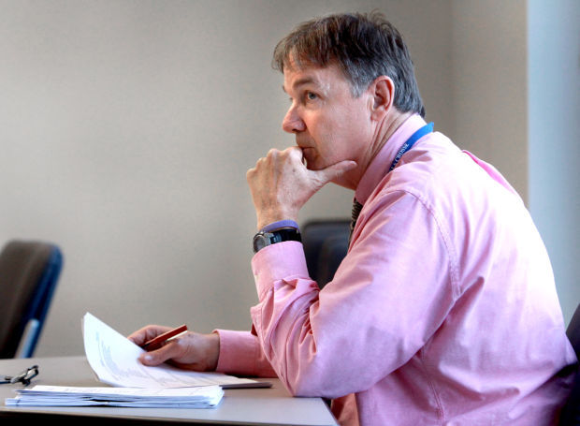
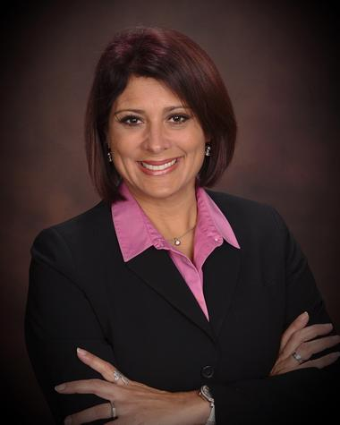
Intro to personas
John Boykin, UX
info@ApplegateLLC.com

Slide 2
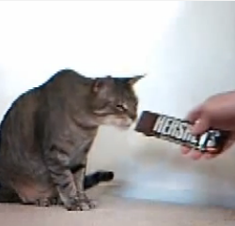
UX is about satisfying the cat
Personas are a way of understanding the cat

Slide 3
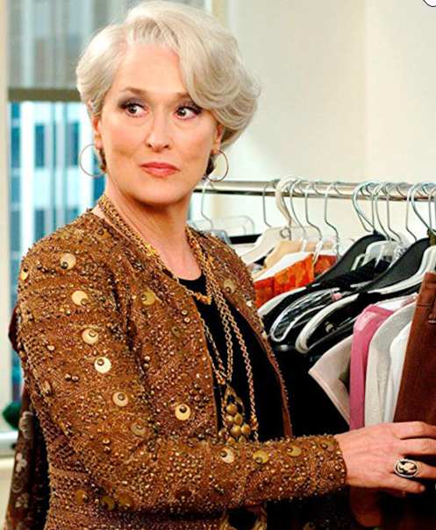
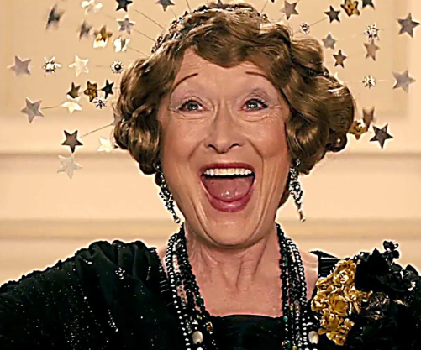
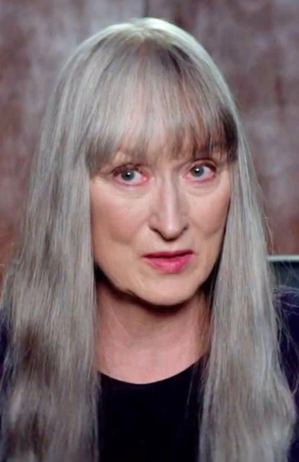
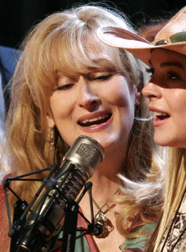
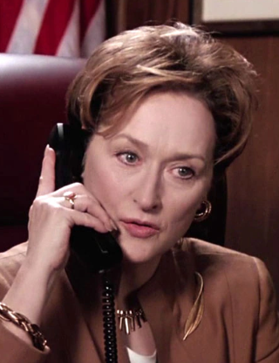
Actor inhabits a character, does not play herself
Likewise, designers design for personas, not for themselves

Slide 4
Case study
Parking garage
Illustrates how personas differ from marketing segments, etc.

Slide 5
Every demographic
Young
Rich
Educated
Employed
Blue collar
Able
Hetero
Republican
Introverted
Upper class
Etc.
Old
Poor
Uneducated
Unemployed
White collar
Disabled, color blind
LGBTQ+
Democrat
Extroverted
Lower class
Etc.

Slide 6
Types of users (personas)
Regulars
Monthly pass
Work/school nearby
Public transit commuters
Occasionals
Local shoppers
Nearby office visitors
Theater, restaurant, date
First-timers
Out-of-towners on errands
New to town
Tourists

Slide 7
All similar needs & goals
Park close to destination
Save money
Feel safe & secure
Never wander around lost
Not get mugged
Car not broken into, stolen
Feel confident on foot
Where are elevators, stairs?
Where is bathroom?
Where & how do I pay?
Which way to destination?
Way back to garage later?
Where did I park?
This is where personas come into play:
Satisfying primary persona’s needs & goals will satisfy others’ too

Slide 8
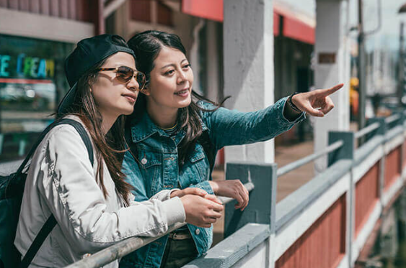
PARKING GARAGE
Primary persona:
Secondary persona:
Optional tertiary persona:
Tourist (first timer)
Regular parker
-- Monthly pass process
-- Any special treatment they get
Occasional parker
-- Fewer needs than tourist
-- Probably unnecessary

Slide 9
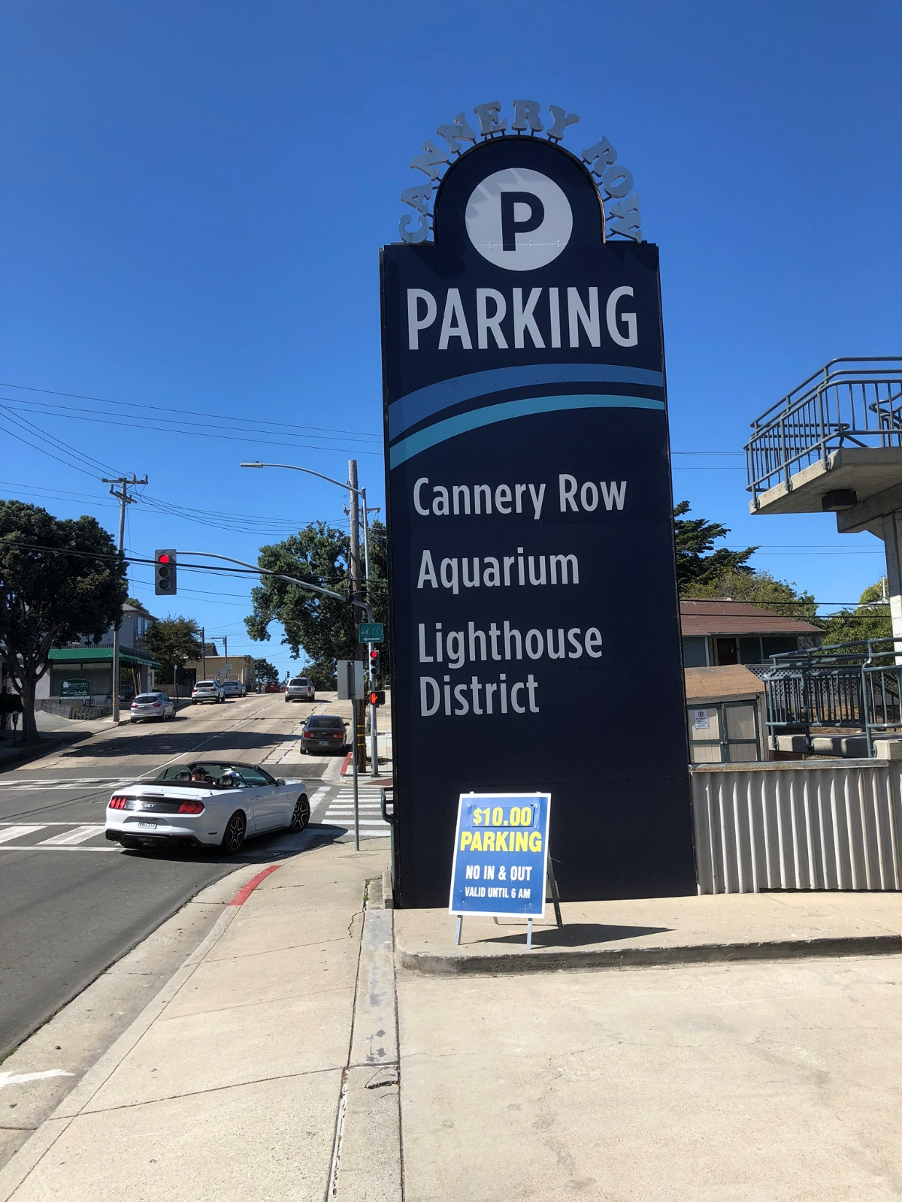
Close to destination
Save money

Slide 10
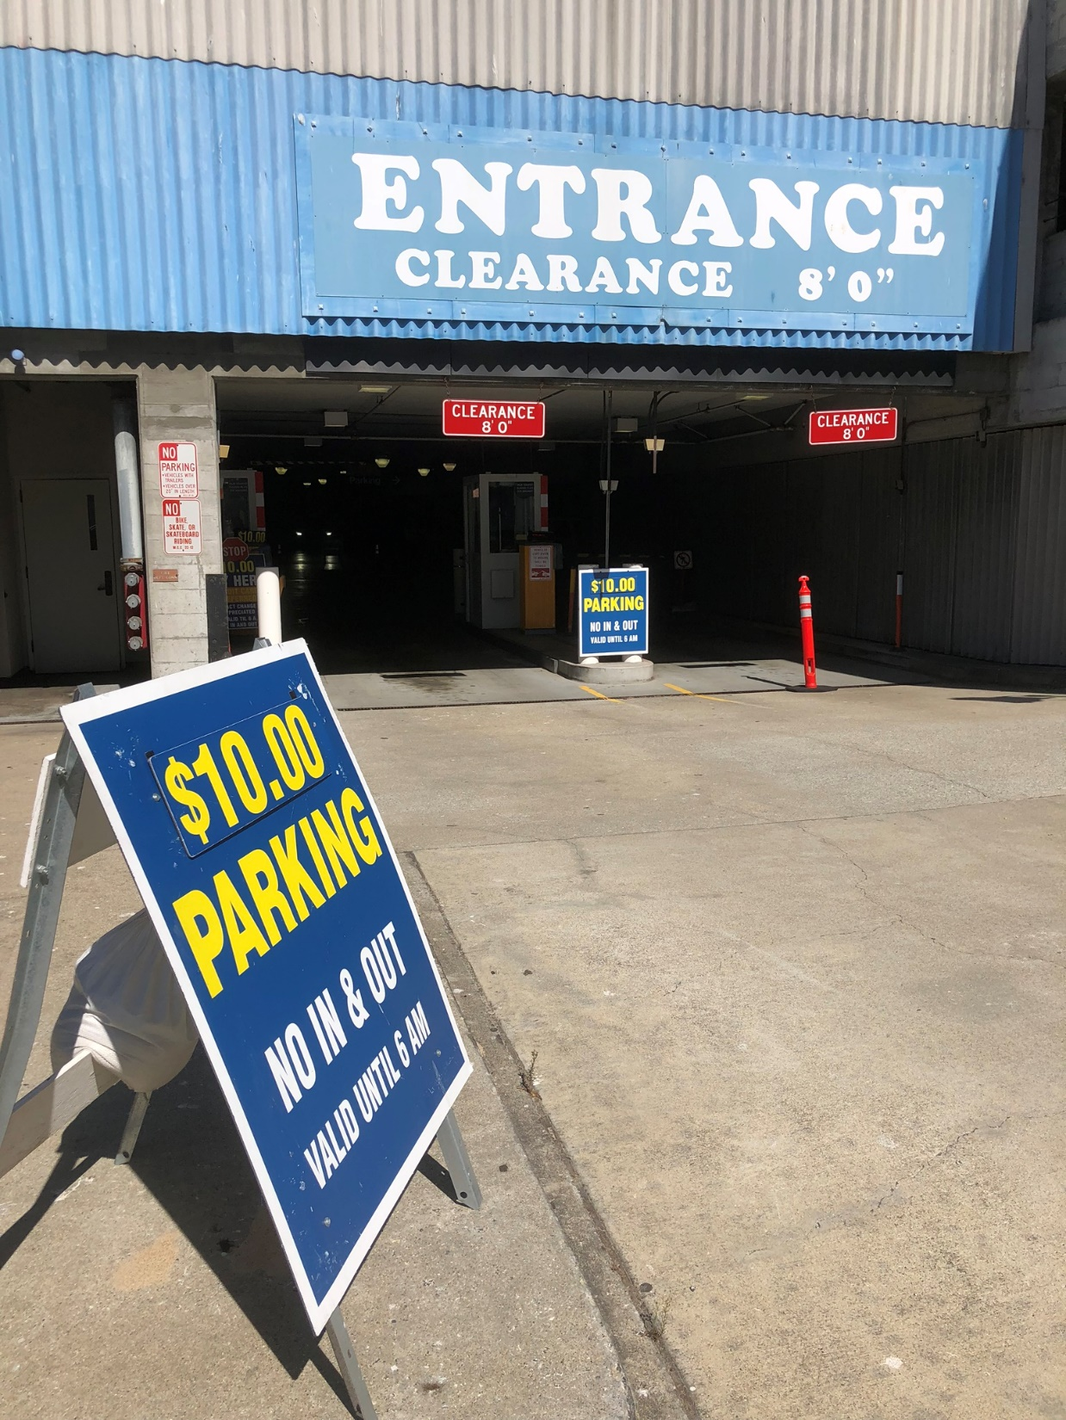
Not lost
Feel confident

Slide 11
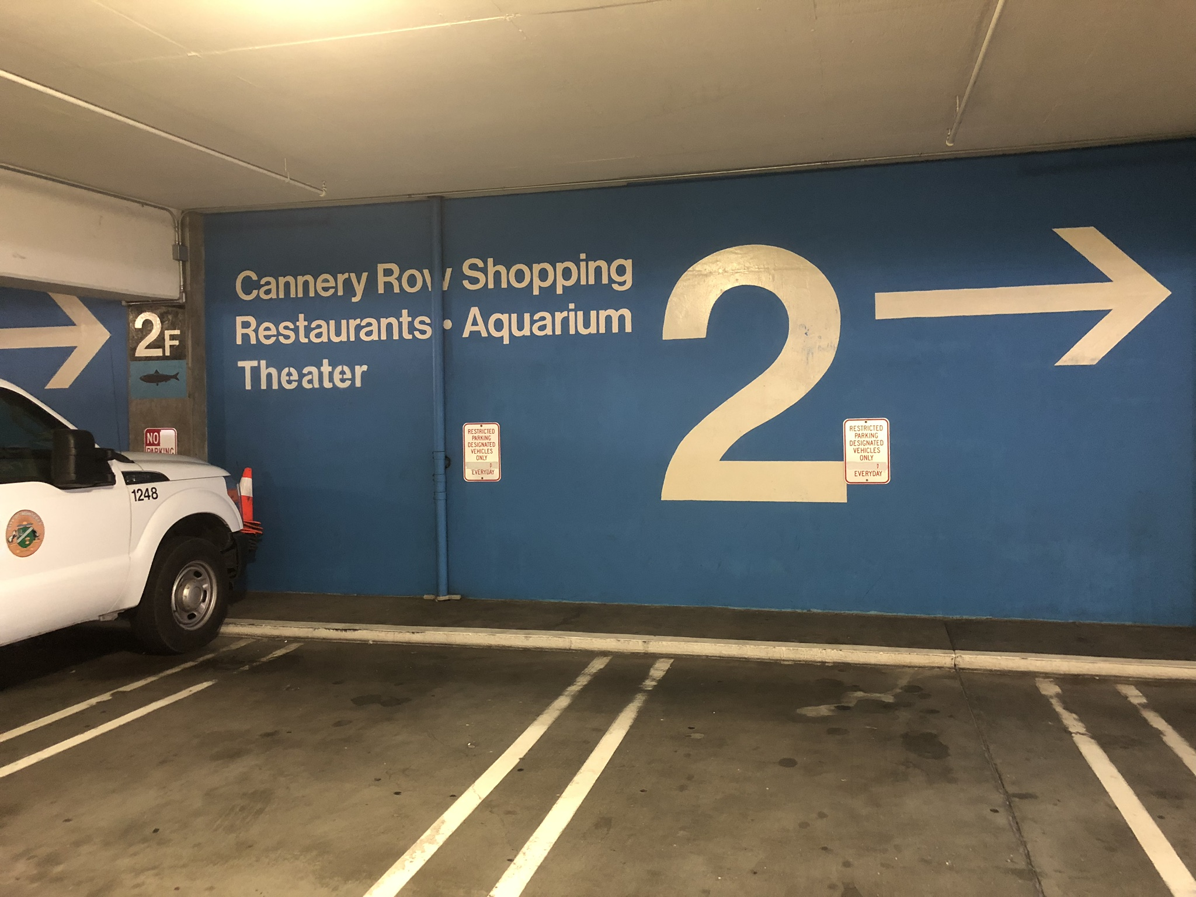
Close to destination
Not wander around lost
Feel confident on foot
Which way to destination?
Where did I park?

Slide 12
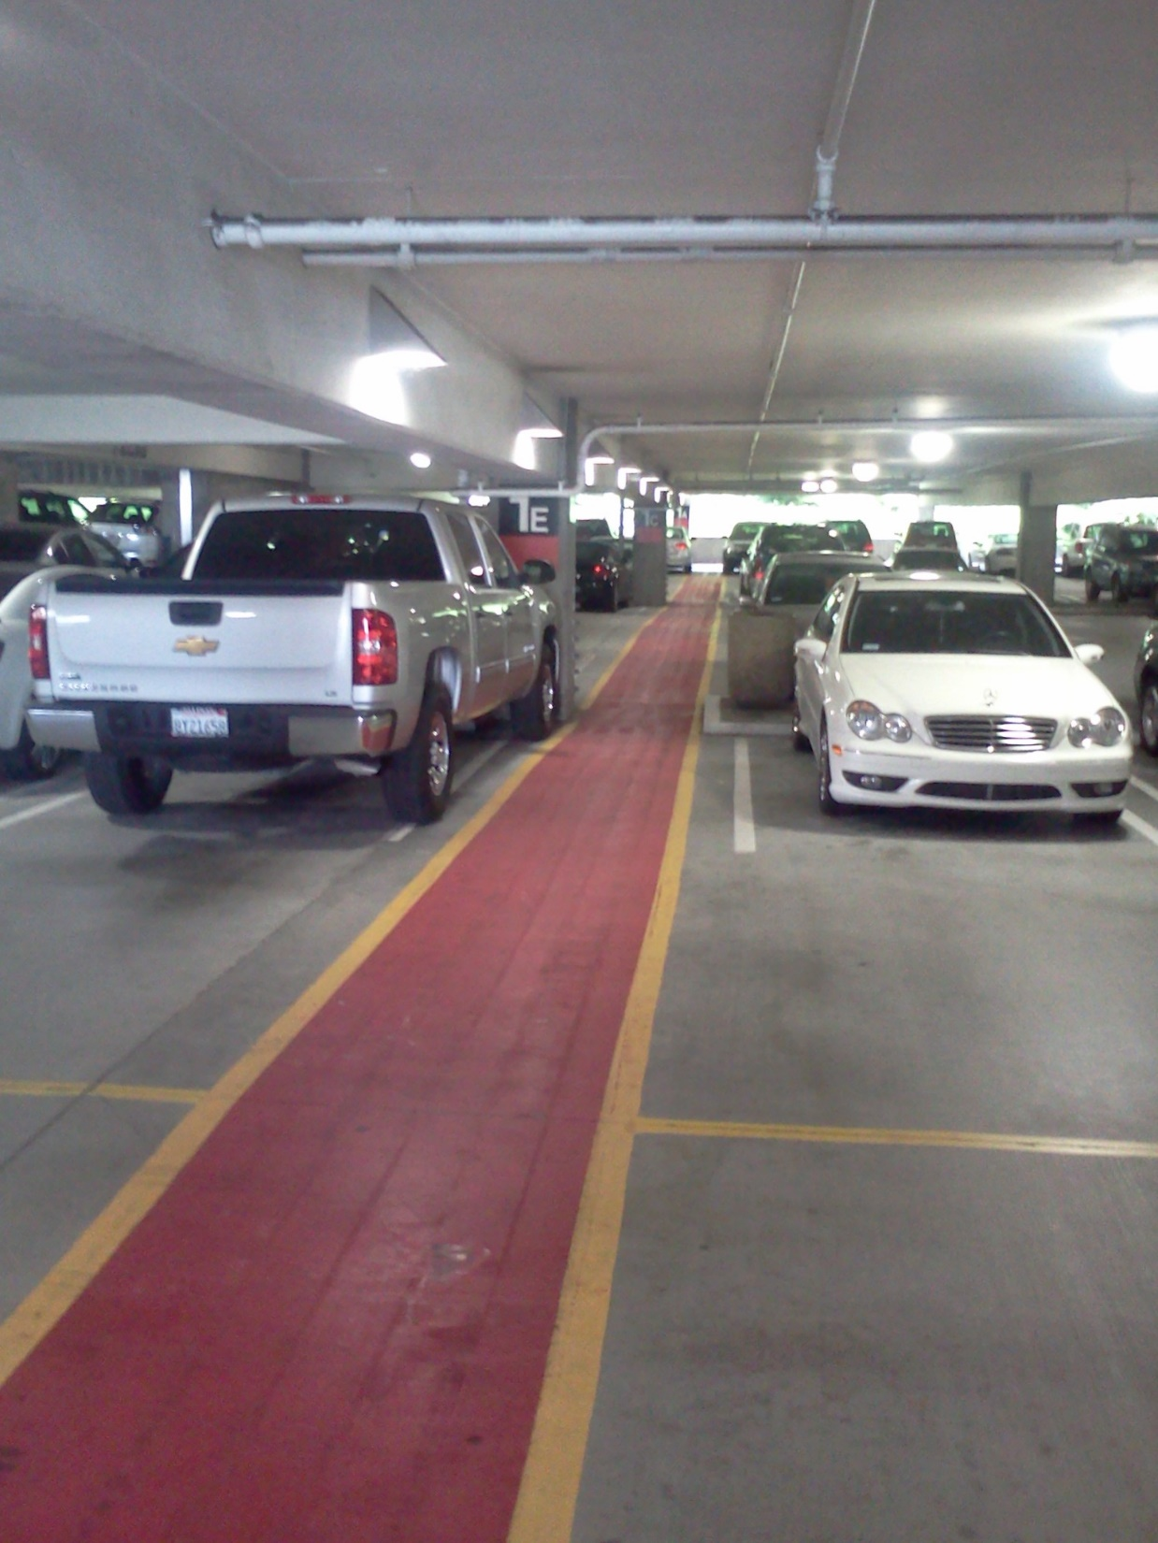
Feel safe & secure
Never wander around lost
Not get mugged
Car not broken into, stolen
Feel confident on foot
Which way to destination?

Slide 13
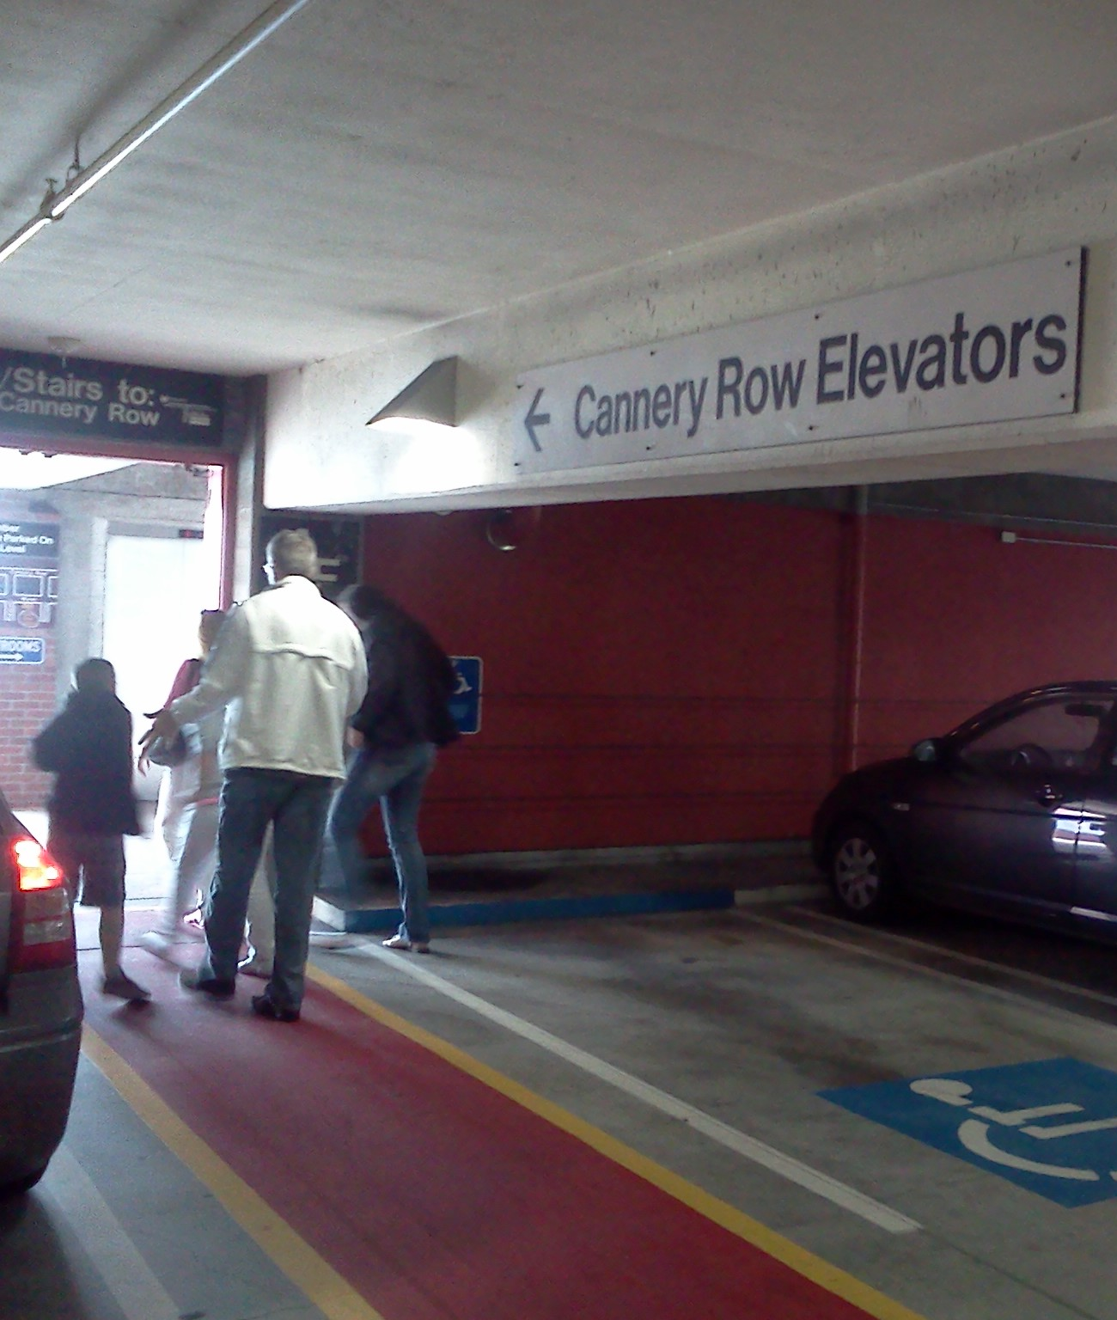
Feel safe & secure
Never wander around lost
Not get mugged
Car not broken into, stolen
Feel confident on foot
Which way to destination?
Where are elevators, stairs?

Slide 14
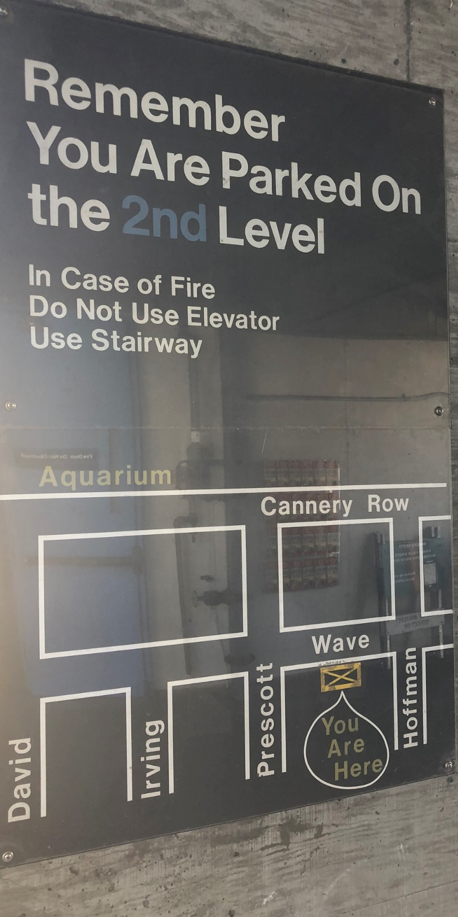
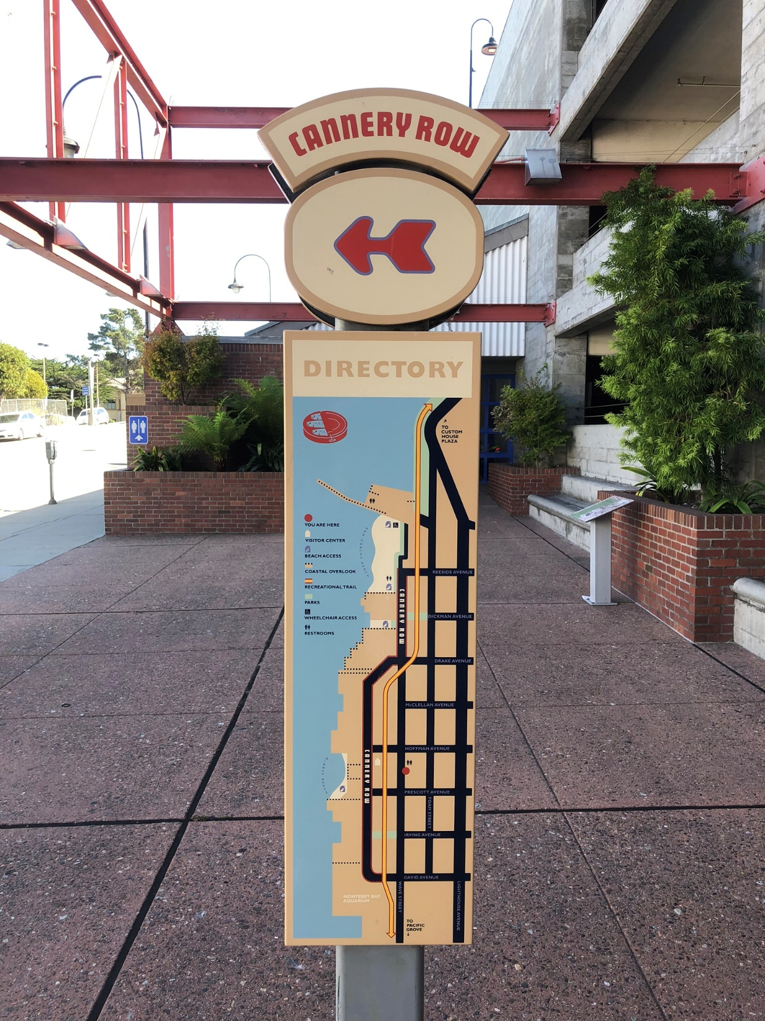
Close to destination
Not wander lost
Confident on foot
Way to destination?
Way back to garage?
Where did I park?

Slide 15
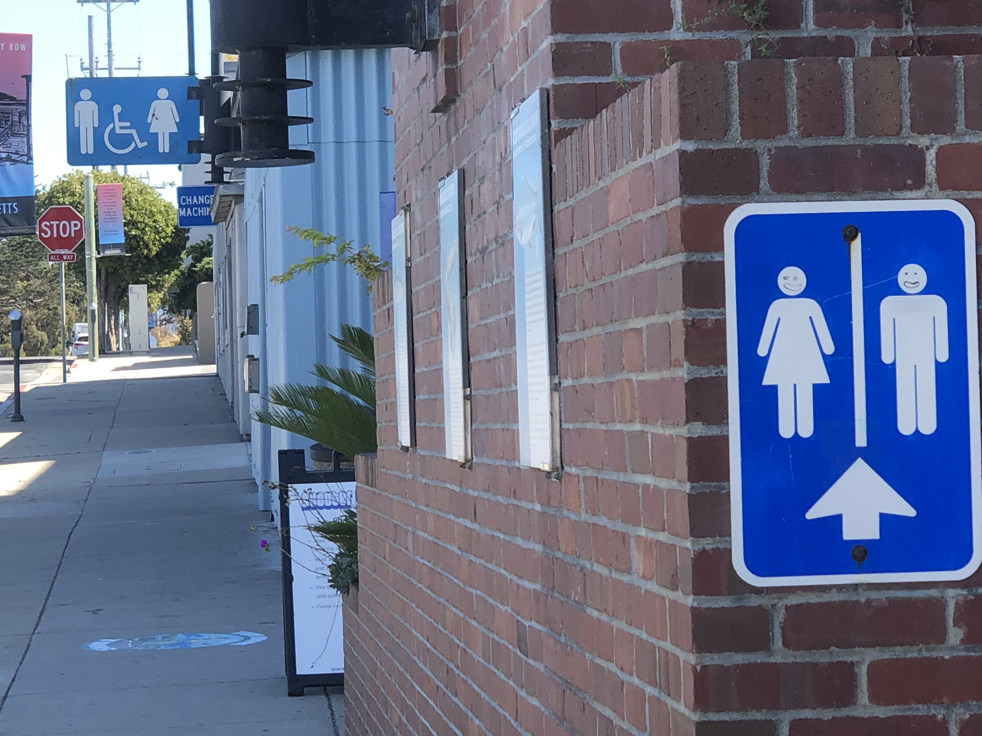
Not wander around lost
Where is bathroom?

Slide 16
PARKING GARAGE
Primary persona:
Secondary persona:
Optional tertiary persona:
Tourist (first timer)
Regular parker
-- Monthly pass process
-- Any special treatment they get
Occasional parker
-- Fewer needs than tourist
-- Probably unnecessary

Slide 17
UPSHOT
Satisfying primary persona’s needs & goals incidentally satisfies others’ too
Park close to destination
Save money
Feel safe & secure
Never wander around lost
Not get mugged
Car not broken into, stolen
Feel confident on foot
Where are elevators, stairs?
Where is bathroom?
Where & how do I pay?
Which way to destination?
Way back to garage later?
Where did I park?

Slide 18
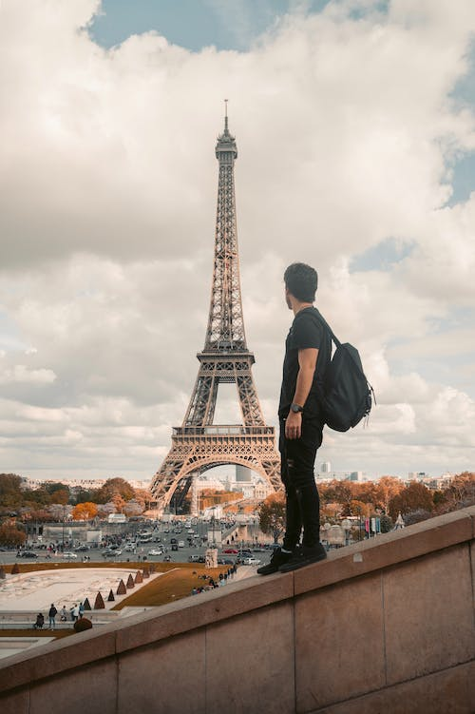
2 sample personas

Slide 19
EXAMPLE
Darren,
Traveler
“I got no time to learn any French”

Slide 20
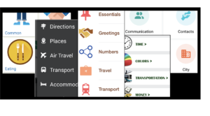
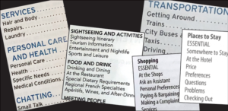
Downloaded app 20 minutes before boarding flight to Paris
Will visit France, Italy, Germany
Lost on streetcorner ¼ mile from station 14 minutes before train departs
Old-fashioned phrasebooks would not work for Darren (textbooks, sections)

Slide 21
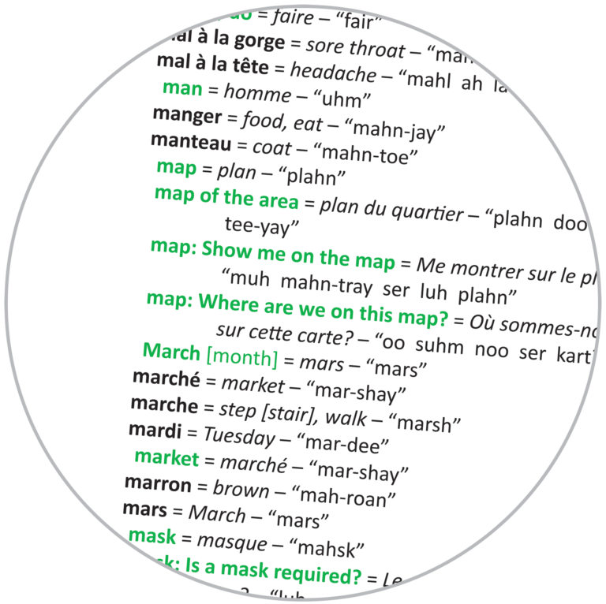
Needs simple glossary form:
Single alpha list
No sections
No lessons
Nothing to find, learn, or figure out

Slide 22
EXAMPLE
Pete, investor
“No surprises.”

Slide 23
Primary investor: Pete
GOALS
“No surprises.”
Get the best ROI with the least nonsense
Feel in charge of his money
See how well his experiment with us pays off
City planner in San Antonio, age 53
Moves from state to state every few years
Control freak accustomed to running the show
Prides himself on his command of the details
Studies past & analyzes present to plan future
Persuaded only by verifiable facts & numbers
Reads the fine print & double-checks the math
Finely calibrated BS detector
Gives anyone one chance -- one
Expects clear, prompt answers w no razzmatazz

Slide 24
Primary investor: Pete
“No surprises.”
REQUIRES FROM SITE
Assurances
his money is in good hands
we won't sell or share his info or get hacked
see where he is in any process & what to expect
no hard hit on credit score
Control, flexibility, options
Ability to
play around with "what if" experimentation
customize tables (idiosyncratic filters, columns, multi-level sort)
specify amount per fund
specify % of total investment to each rating
continue after moving to a different state
Easy access to all the clear, simple info he wants
Overviews on surface, details one click away
See projected & actual returns, all places his money is in now, etc., visually
Be able to customize presentation of info
Generic info
How each aspect of the process works
Explanations & details about ratings on request
Quick access to fund details
Partners, IRA types, why we ask for SSN, etc.
Phone number for customer service
How to get his money out when the time comes

Slide 25
Questions?
Comments?

