Slide 1
Showing Information Do's and Don'ts
John Boykin
www.wayfind.com
© Copyright 2014 John Boykin

Slide 2
Visual noise

Slide 3
Visual noise: BEEB design
BEEB design
B
ox for
E
verything and
E
verything in a
B
ox

Slide 4
Visual noise: BEEB design
BEEB design
B
ox for
E
verything and
E
verything in a
B
ox

Slide 5
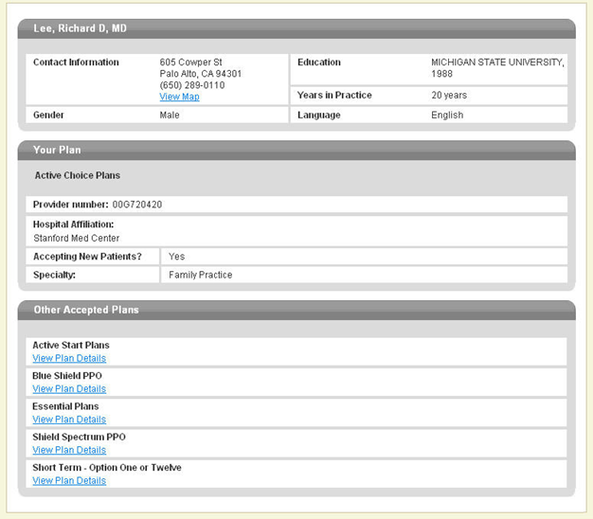
Visual noise: Original

Slide 6
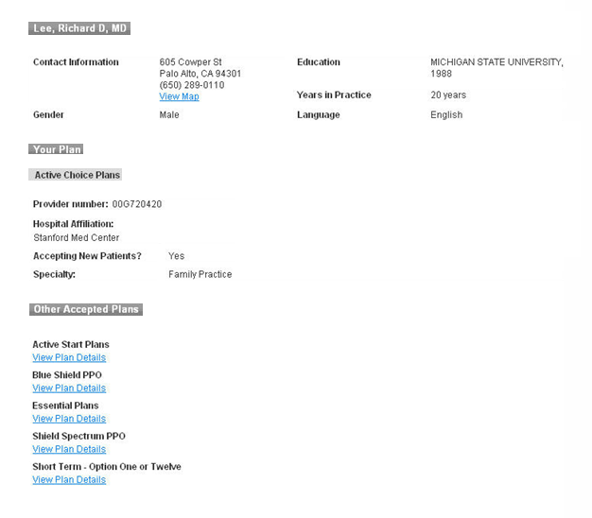
Visual noise: The info

Slide 7
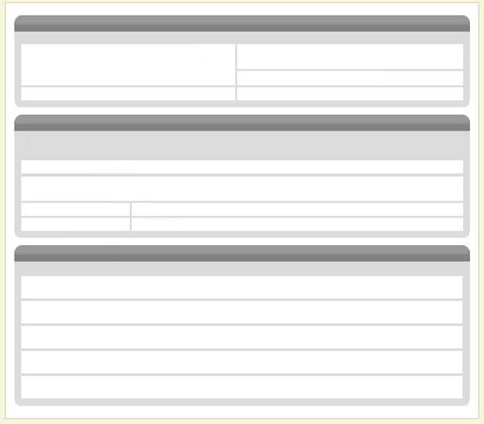
Visual noise: The noise

Slide 8
Visual noise: Original

Slide 9
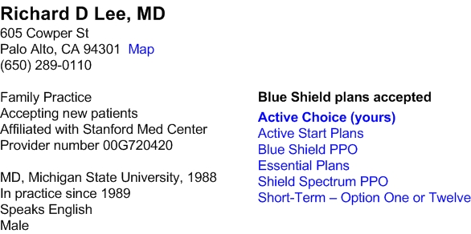
Visual noise: Redesign

Slide 10
Visual noise: Gratuitous elements

Slide 11
Keep related things
together

Slide 13
Related things together
Select zone

Slide 14
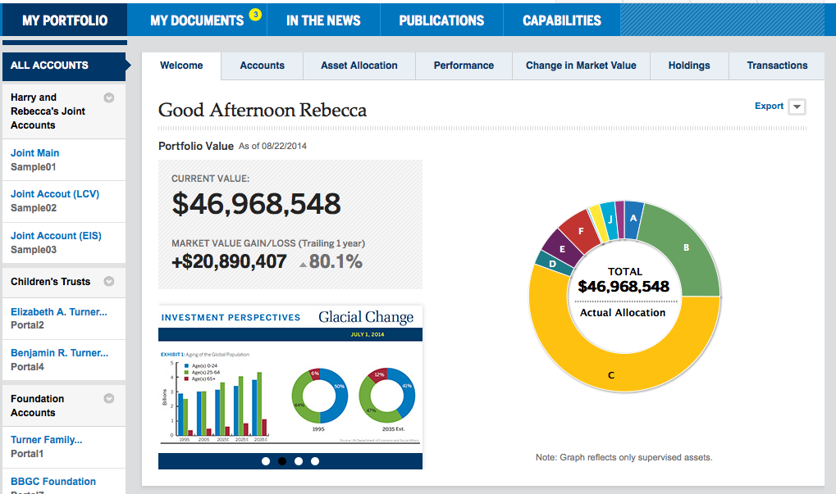
Related things together
Select zone

Slide 15
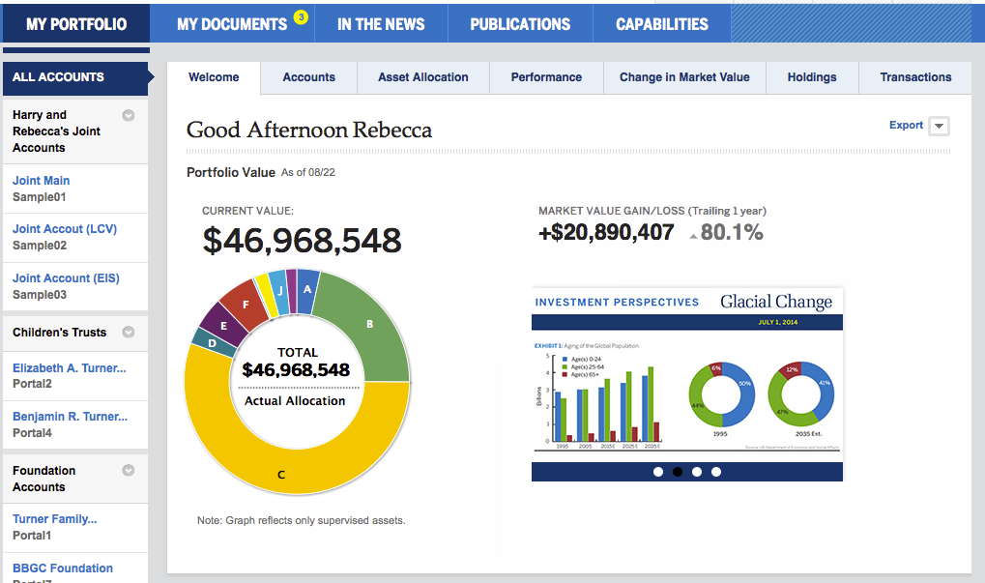
Related things together
Select zone

Slide 16
Table columns
(Related things together, cont.)

Slide 17
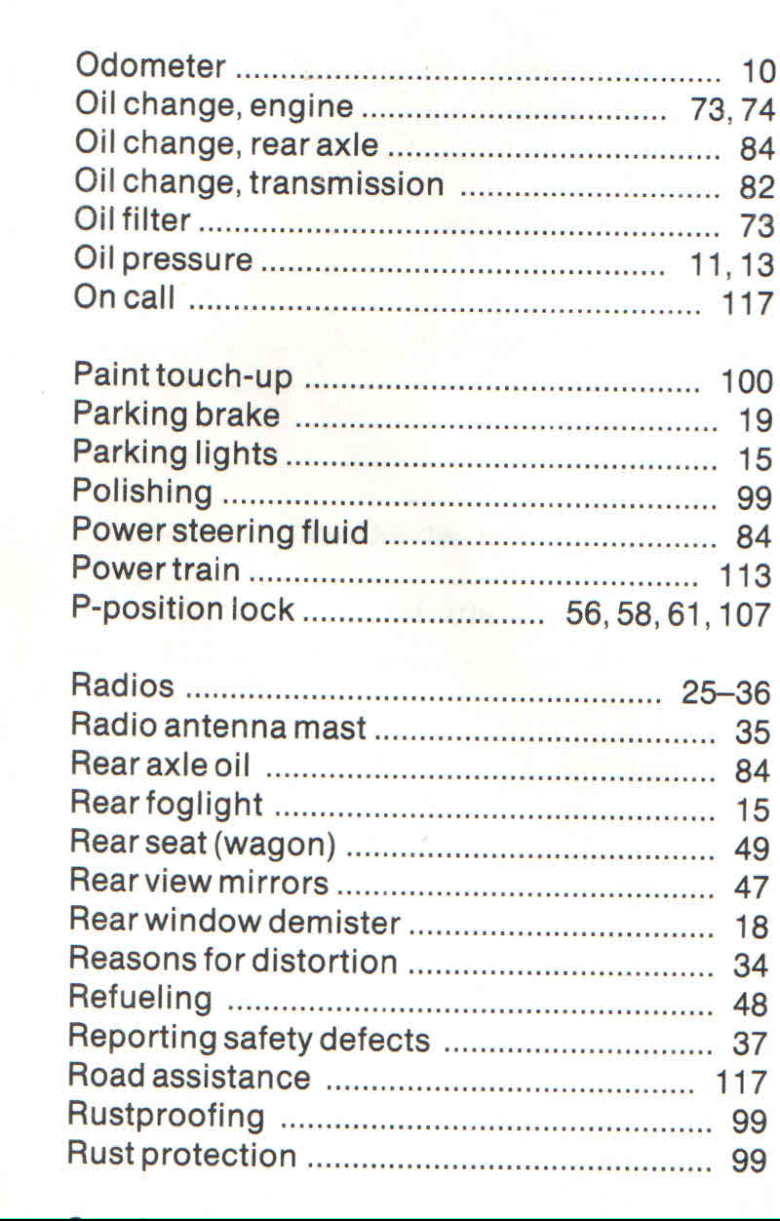
Table columns

Slide 18
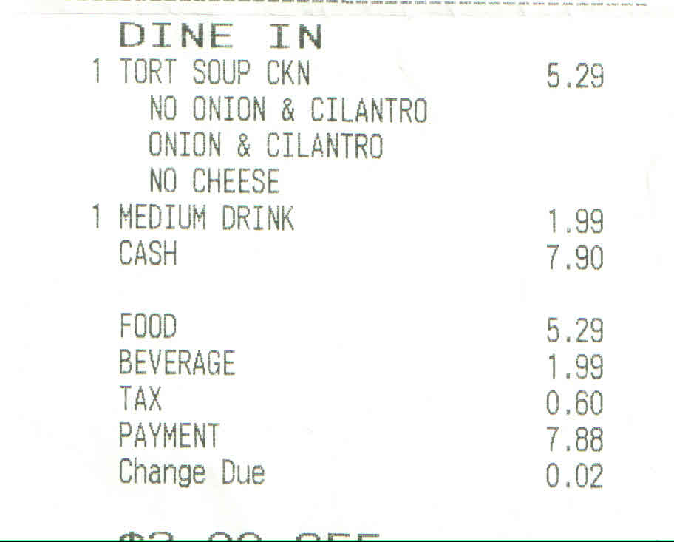
Table columns

Slide 19
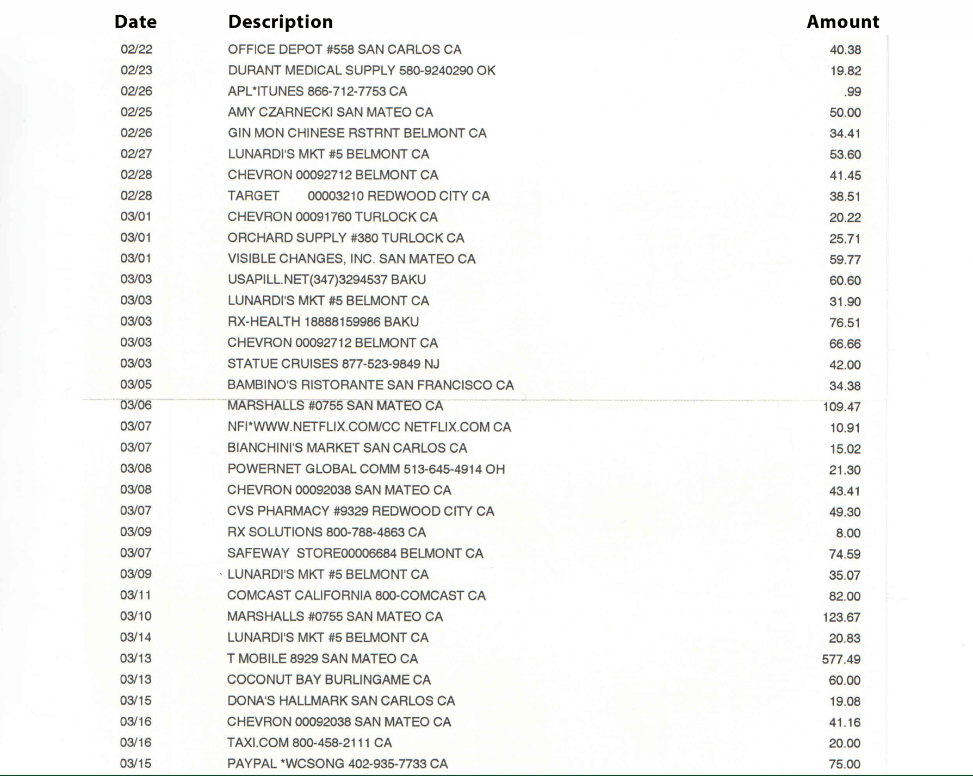
Table columns

Slide 20
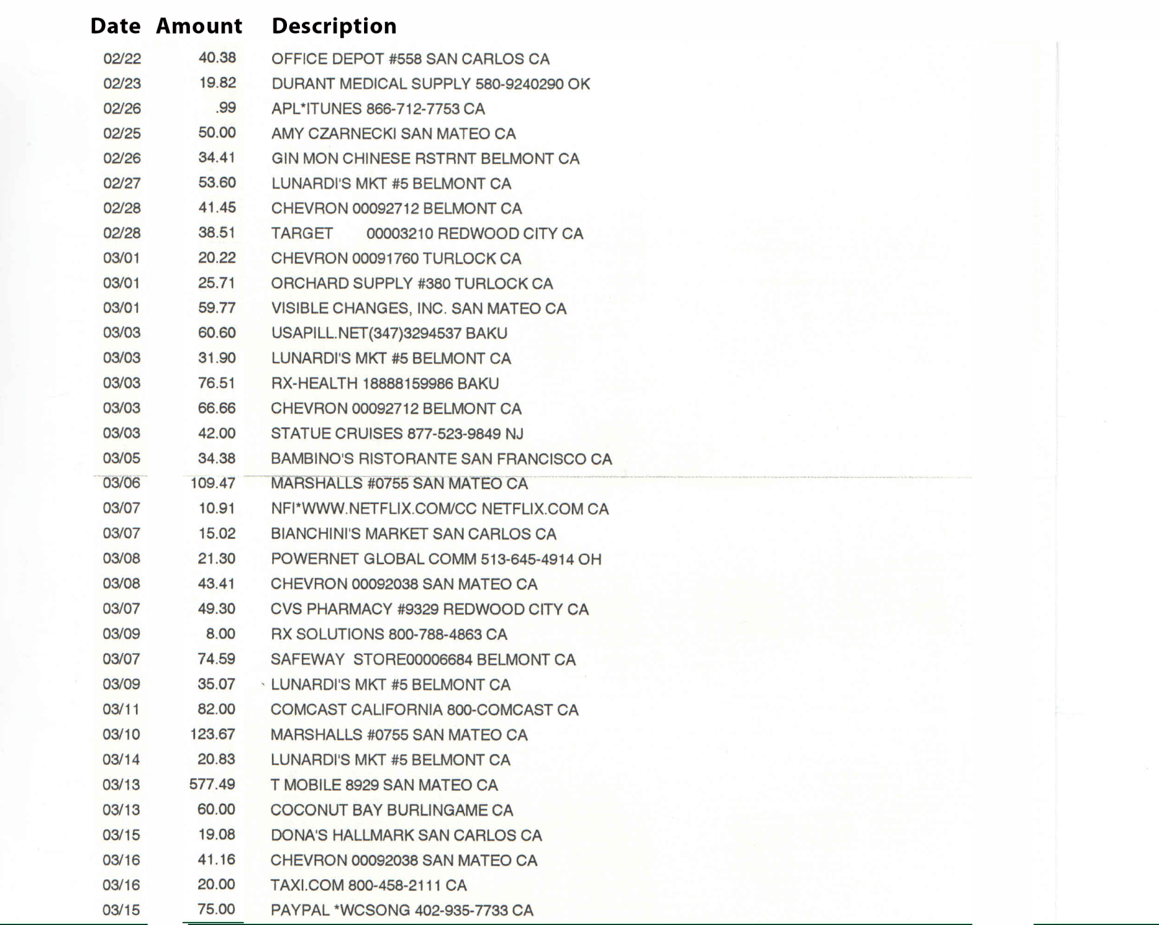
Table columns

Slide 21
Pie charts

Slide 22
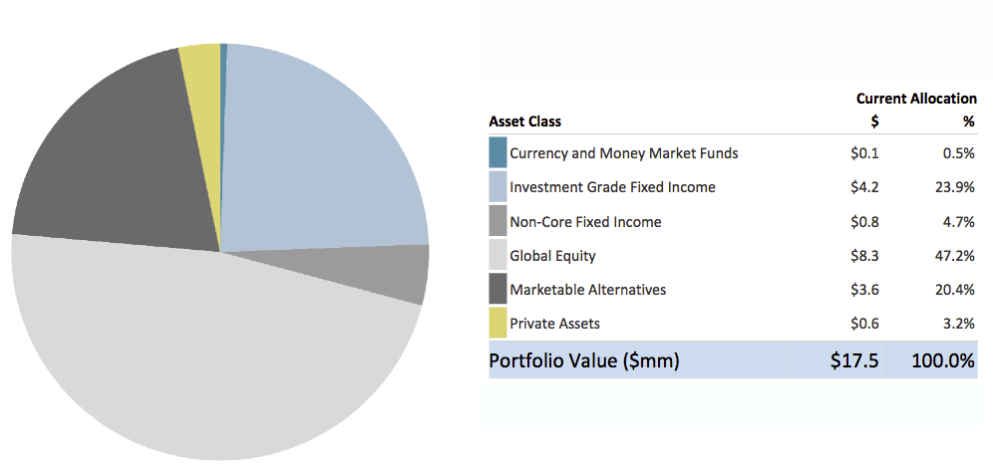
Pie charts

Slide 23
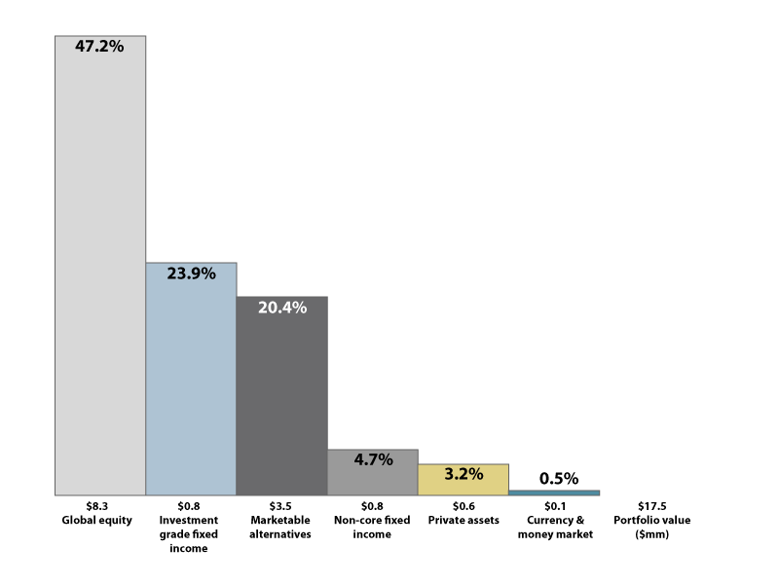
Pie charts

Slide 24
Color blindness

Slide 25
Color blindness
How many colors? What are they?

Slide 26
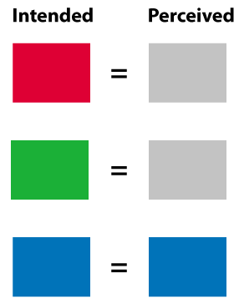
Color blindness

Slide 27
Color blindness
Color code

Slide 28
Color blindness
colorblind

Slide 29
Color blindness
2+ dimensions

Slide 30
Massive amounts of data at a glance

Slide 31
Massive amounts of data
http://www.marketwatch.com/tools/stockresearch/marketmap

Slide 32
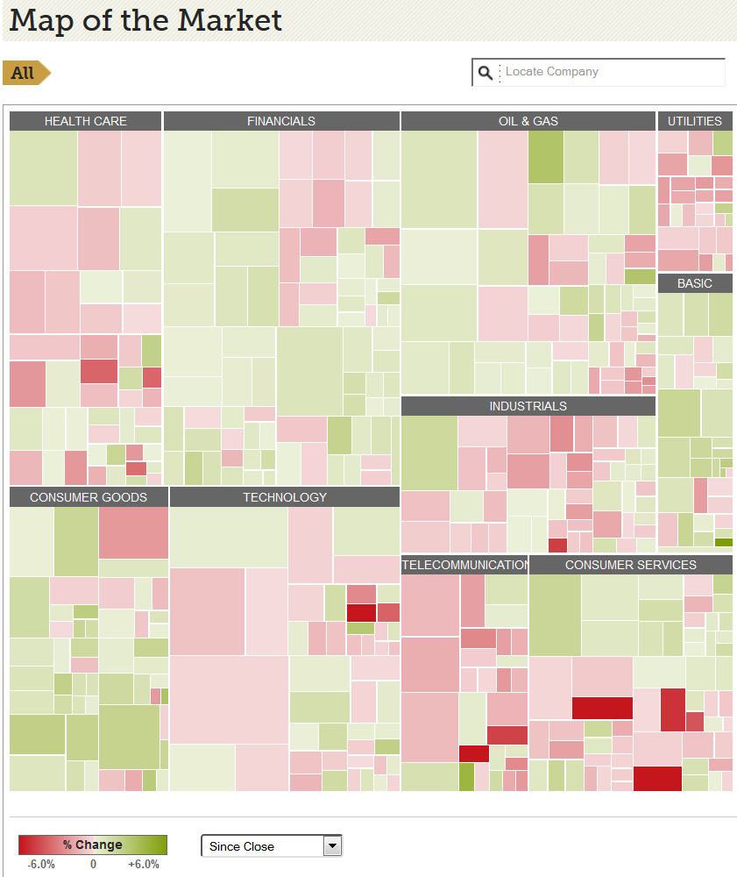
Massive amounts of data

Slide 33
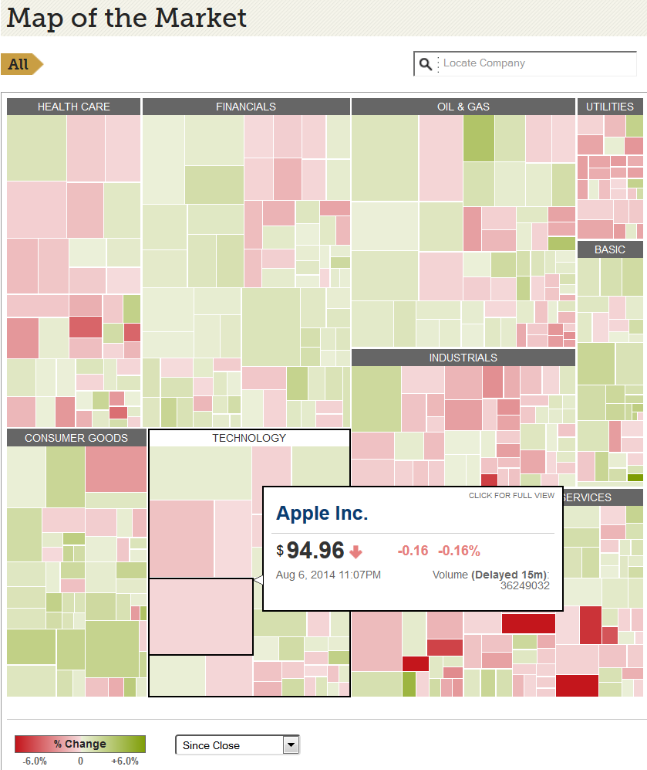
Massive amounts of data

Slide 34
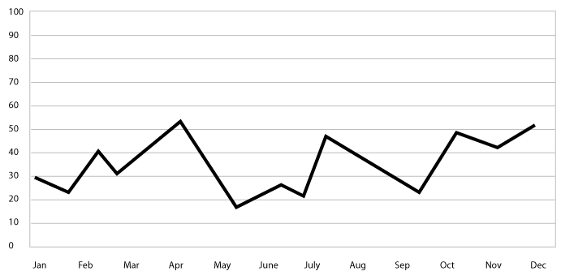
Massive amounts of data

Slide 35
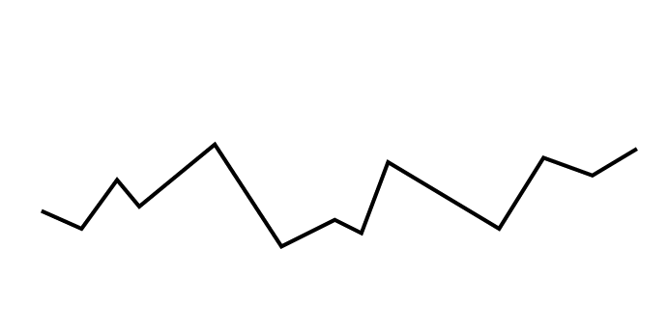
Massive amounts of data

Slide 36
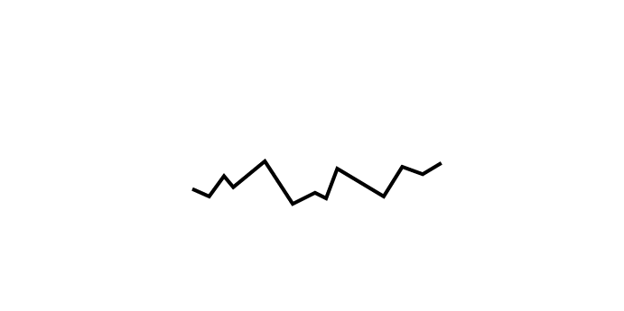
Massive amounts of data

Slide 37
Massive amounts of data: Sparkline

Slide 38
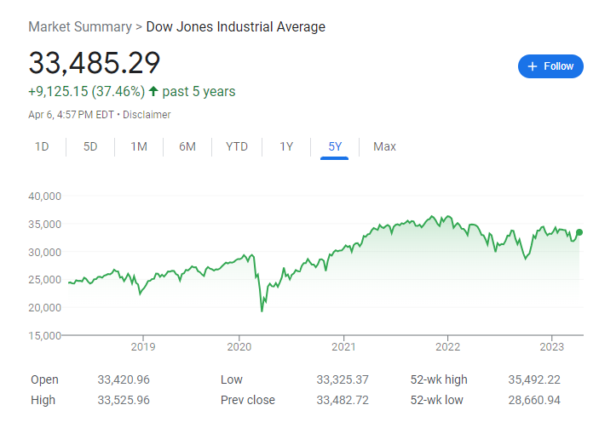
Massive amounts of data: Sparkline
Actual example: Dow 5 years

Slide 39
Massive amounts of data: Sparkline
Actual example: Dow 5 years

Slide 40
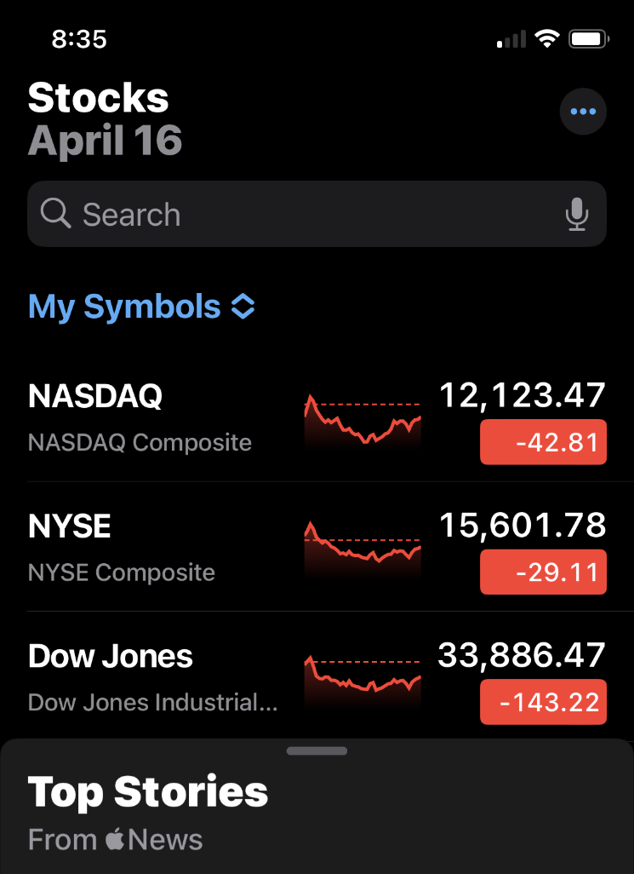
Massive amounts of data: Sparkline
Actual example: Dow, NASDAQ, NYSE 1 day (Apple Stocks app)

Slide 41
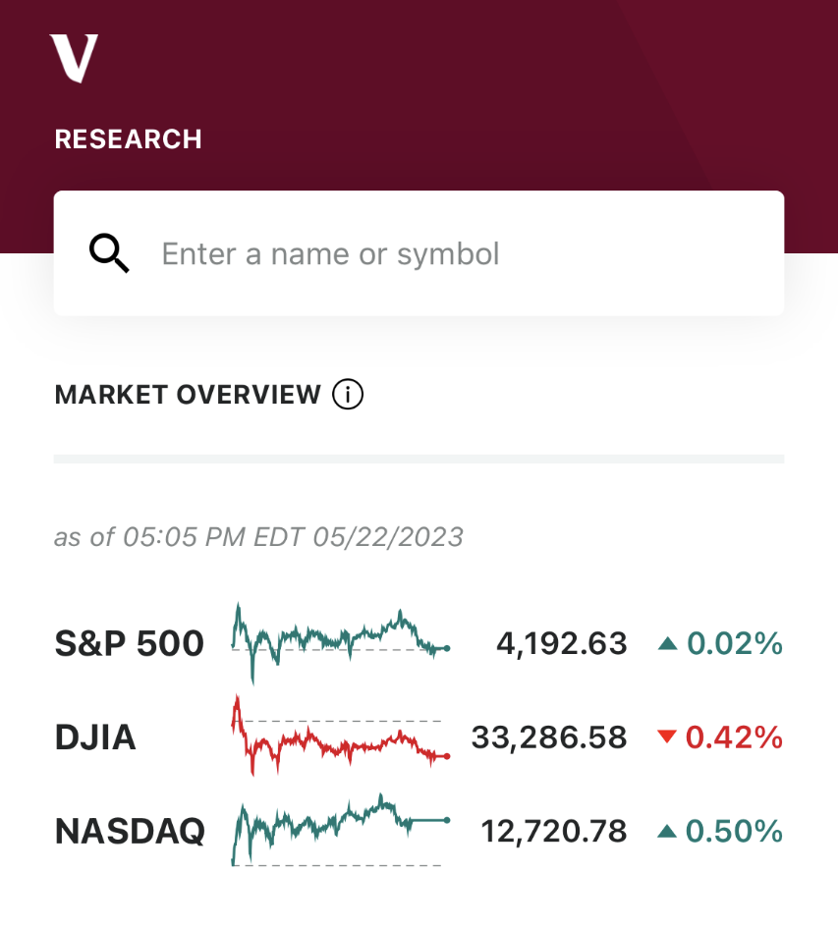
Massive amounts of data: Sparkline
Actual example: Dow, NASDAQ, S&P 1 day (Vanguard app)

Slide 42
Recap
Do
Don’t
Spotlight the data
Minimize table column widths
Put ragged table column rightmost
Prefer bar charts
Use 2+ dimensions of difference
Place elements to reflect their relation
Use muted colors, gray lines
Make every pixel earn its keep
Use treemaps & sparklines
If you must have a line, make it gray
Don't emphasize the container
Don't make table columns needlessly wide
Don't put ragged column in middle of table
Don't use pie charts
Don't rely on color alone to convey meaning
Don't separate related elements
Don't use strong colors
Don't overdo stripes, boxes, lines, shades
Don't forget colorblindness

