Slide 1
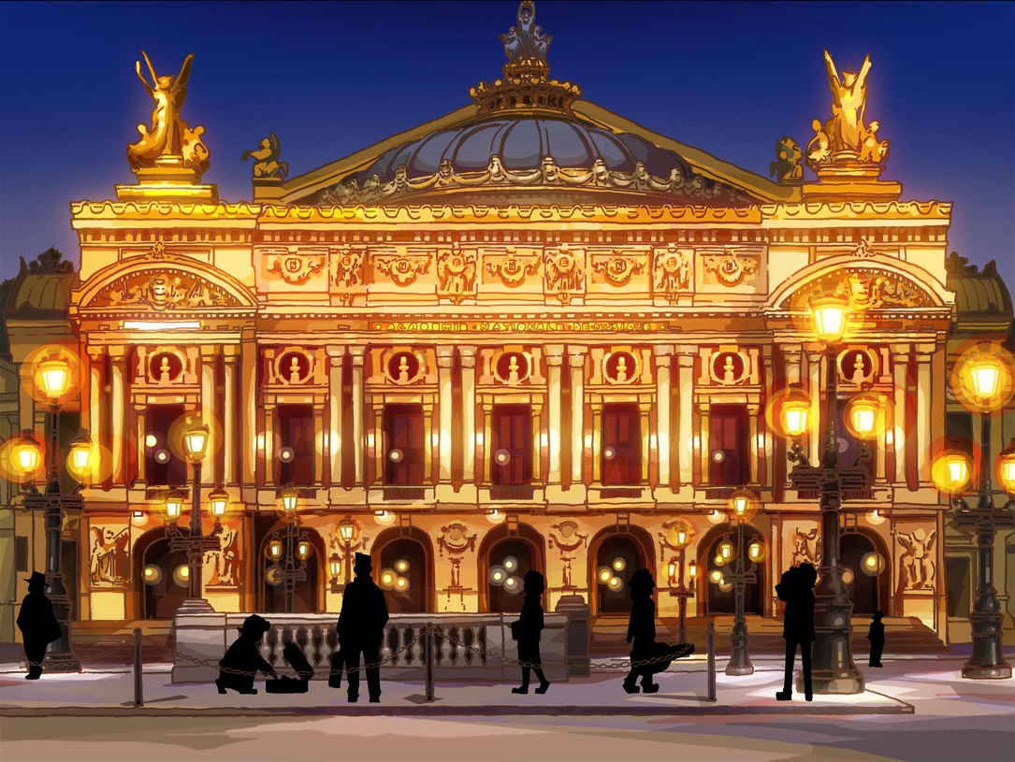
The UX of the
Paris Opera House
John Boykin
info@ApplegateLLC.com

Slide 2
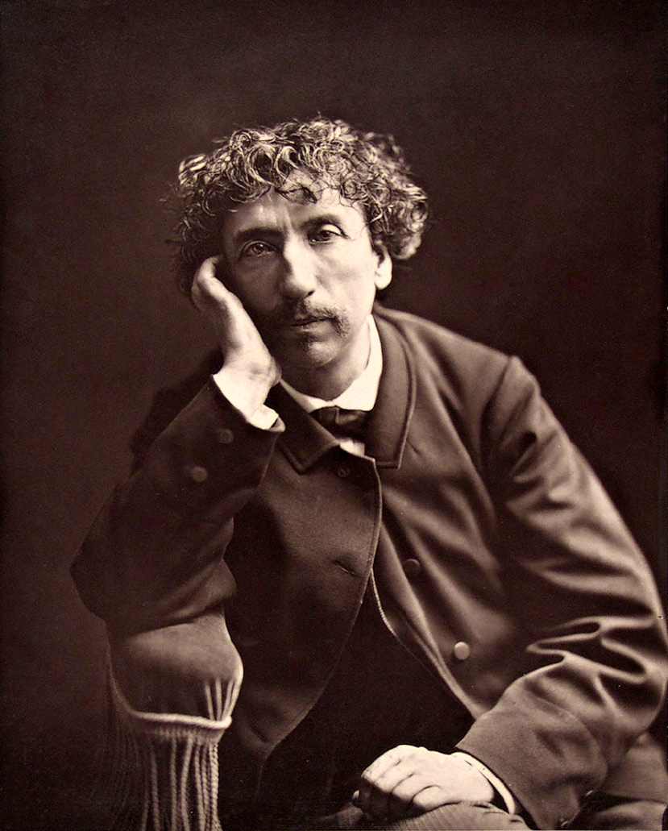
Charles Garnier, architect
Studied how crowds
circulate through public spaces
interact
loiter
Studied
how far apart strangers need to sit and stand to feel comfortable
why people went to the opera

Slide 3
Key insight
Most people did not go to the opera for the opera
Most went for the social experience:
Who else is here?
Who are they with?
How do they look?
Show off my finery, jewels, partner, grace
So Garnier designed first for people to see and be seen
Aesthetics and music came in second

Slide 4
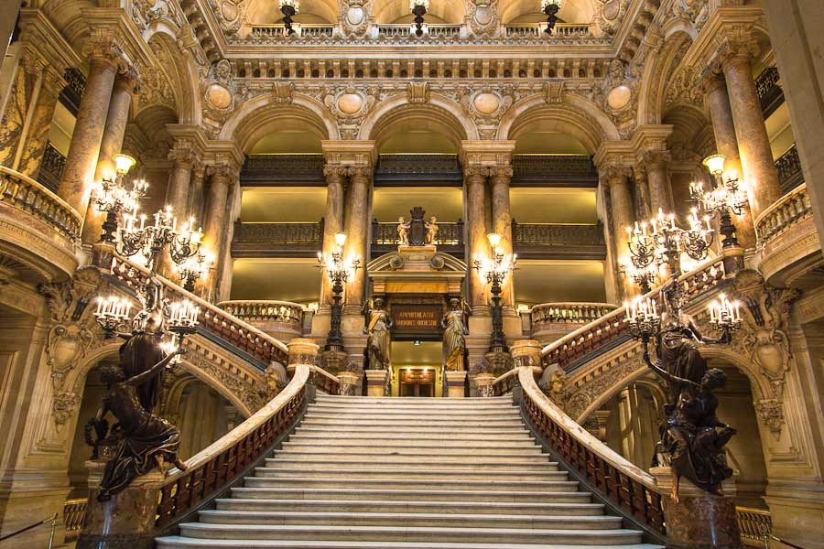
Stairway

Slide 5
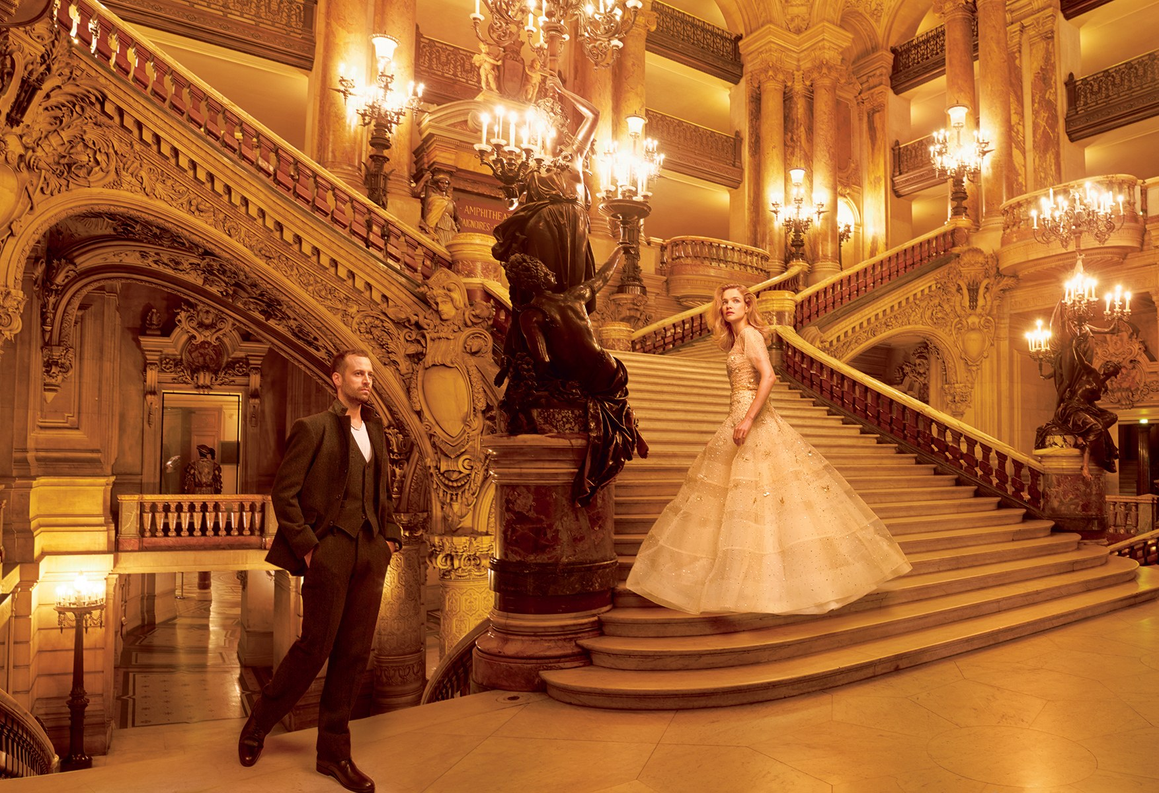
Stairway
Short steps so women in gowns can step gracefully

Slide 6
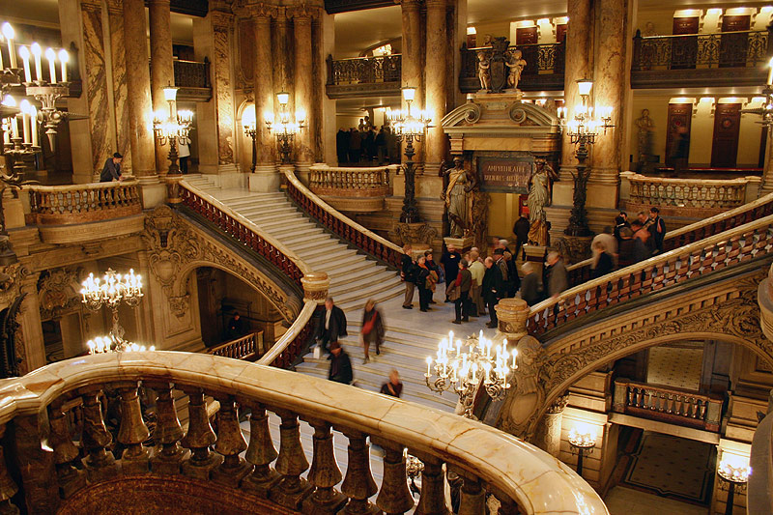
Stairway
Surrounding balconies to watch

Slide 7
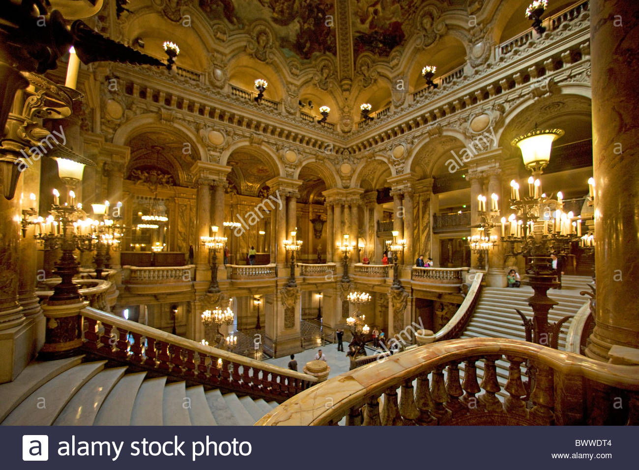
Stairway

Slide 8
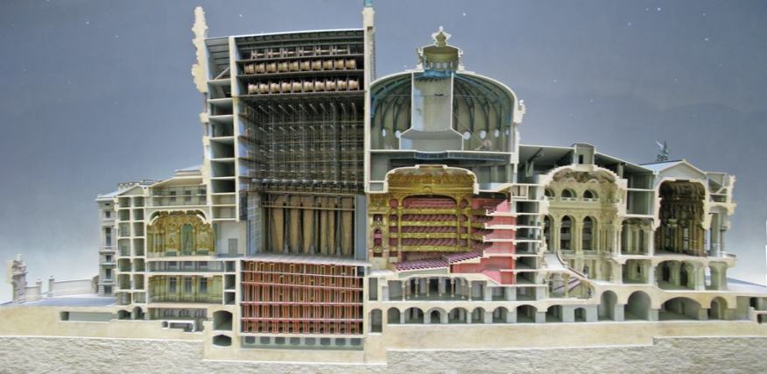
Cross section of huge building
Theatre seats only ~2,000
Stage
Theatre
Stairway
Foyer

Slide 9
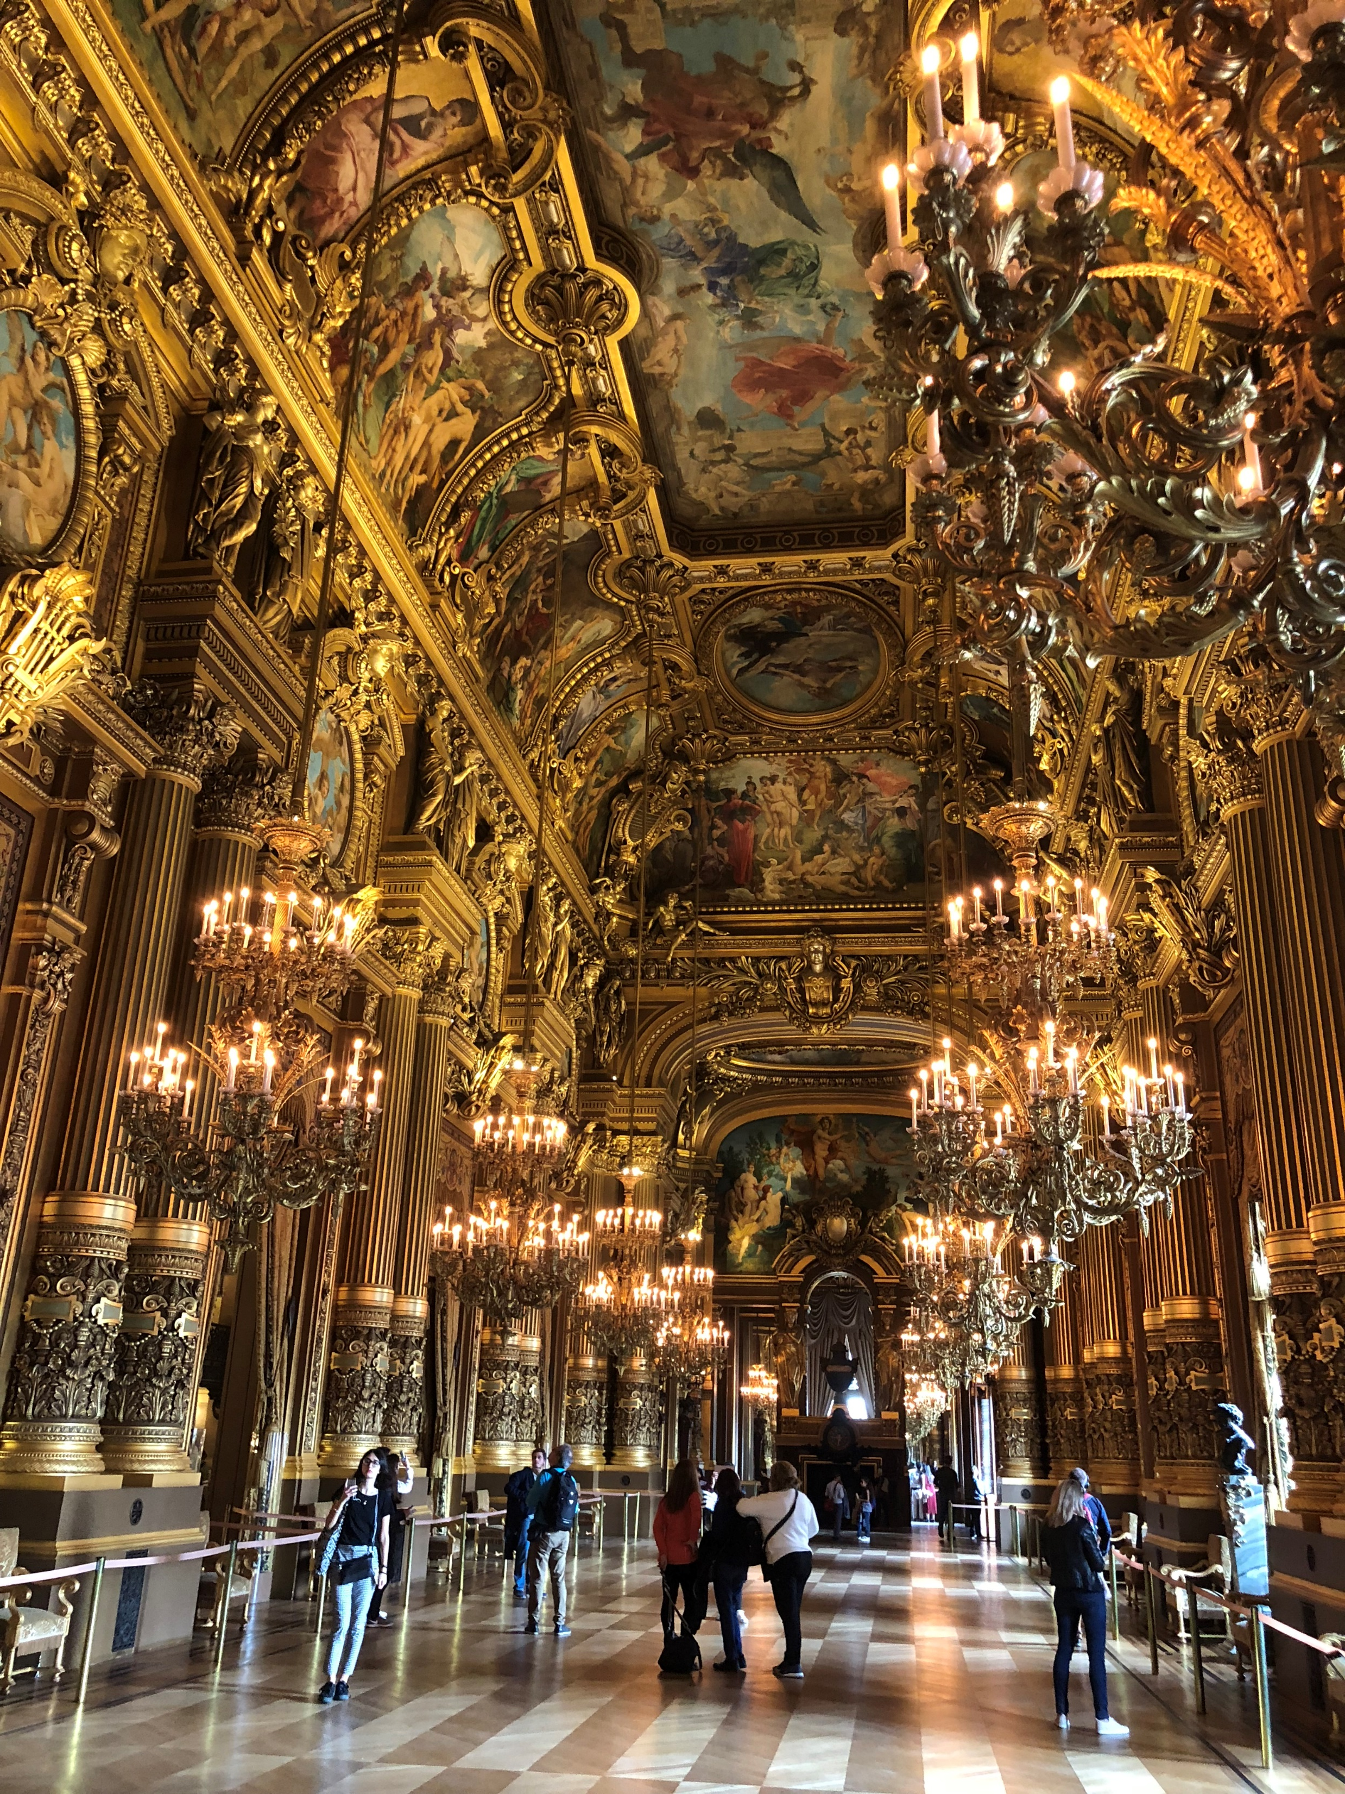
Foyer

Slide 10
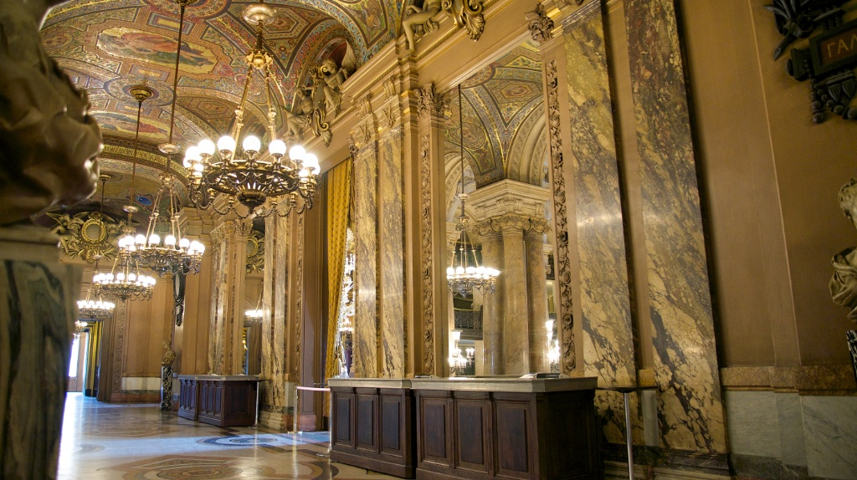
Mirrors

Slide 11
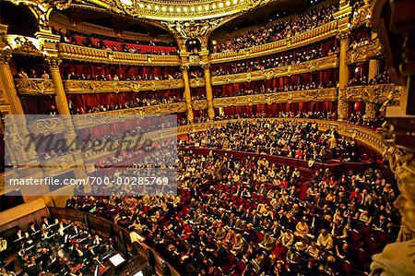
Theatre
Horseshoe shape so everyone can see everyone

Slide 12
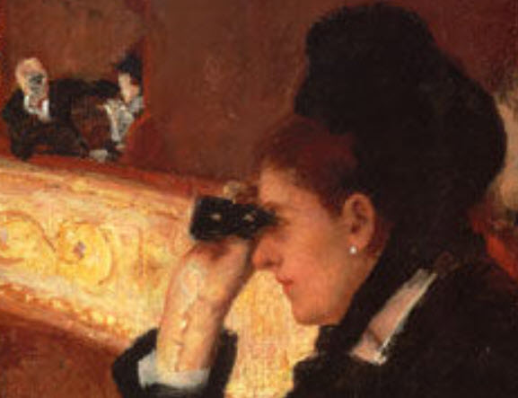
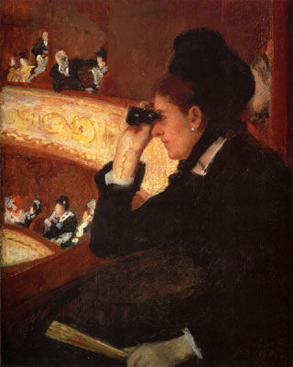
Theatre
Horseshoe shape so everyone can see everyone

Slide 13
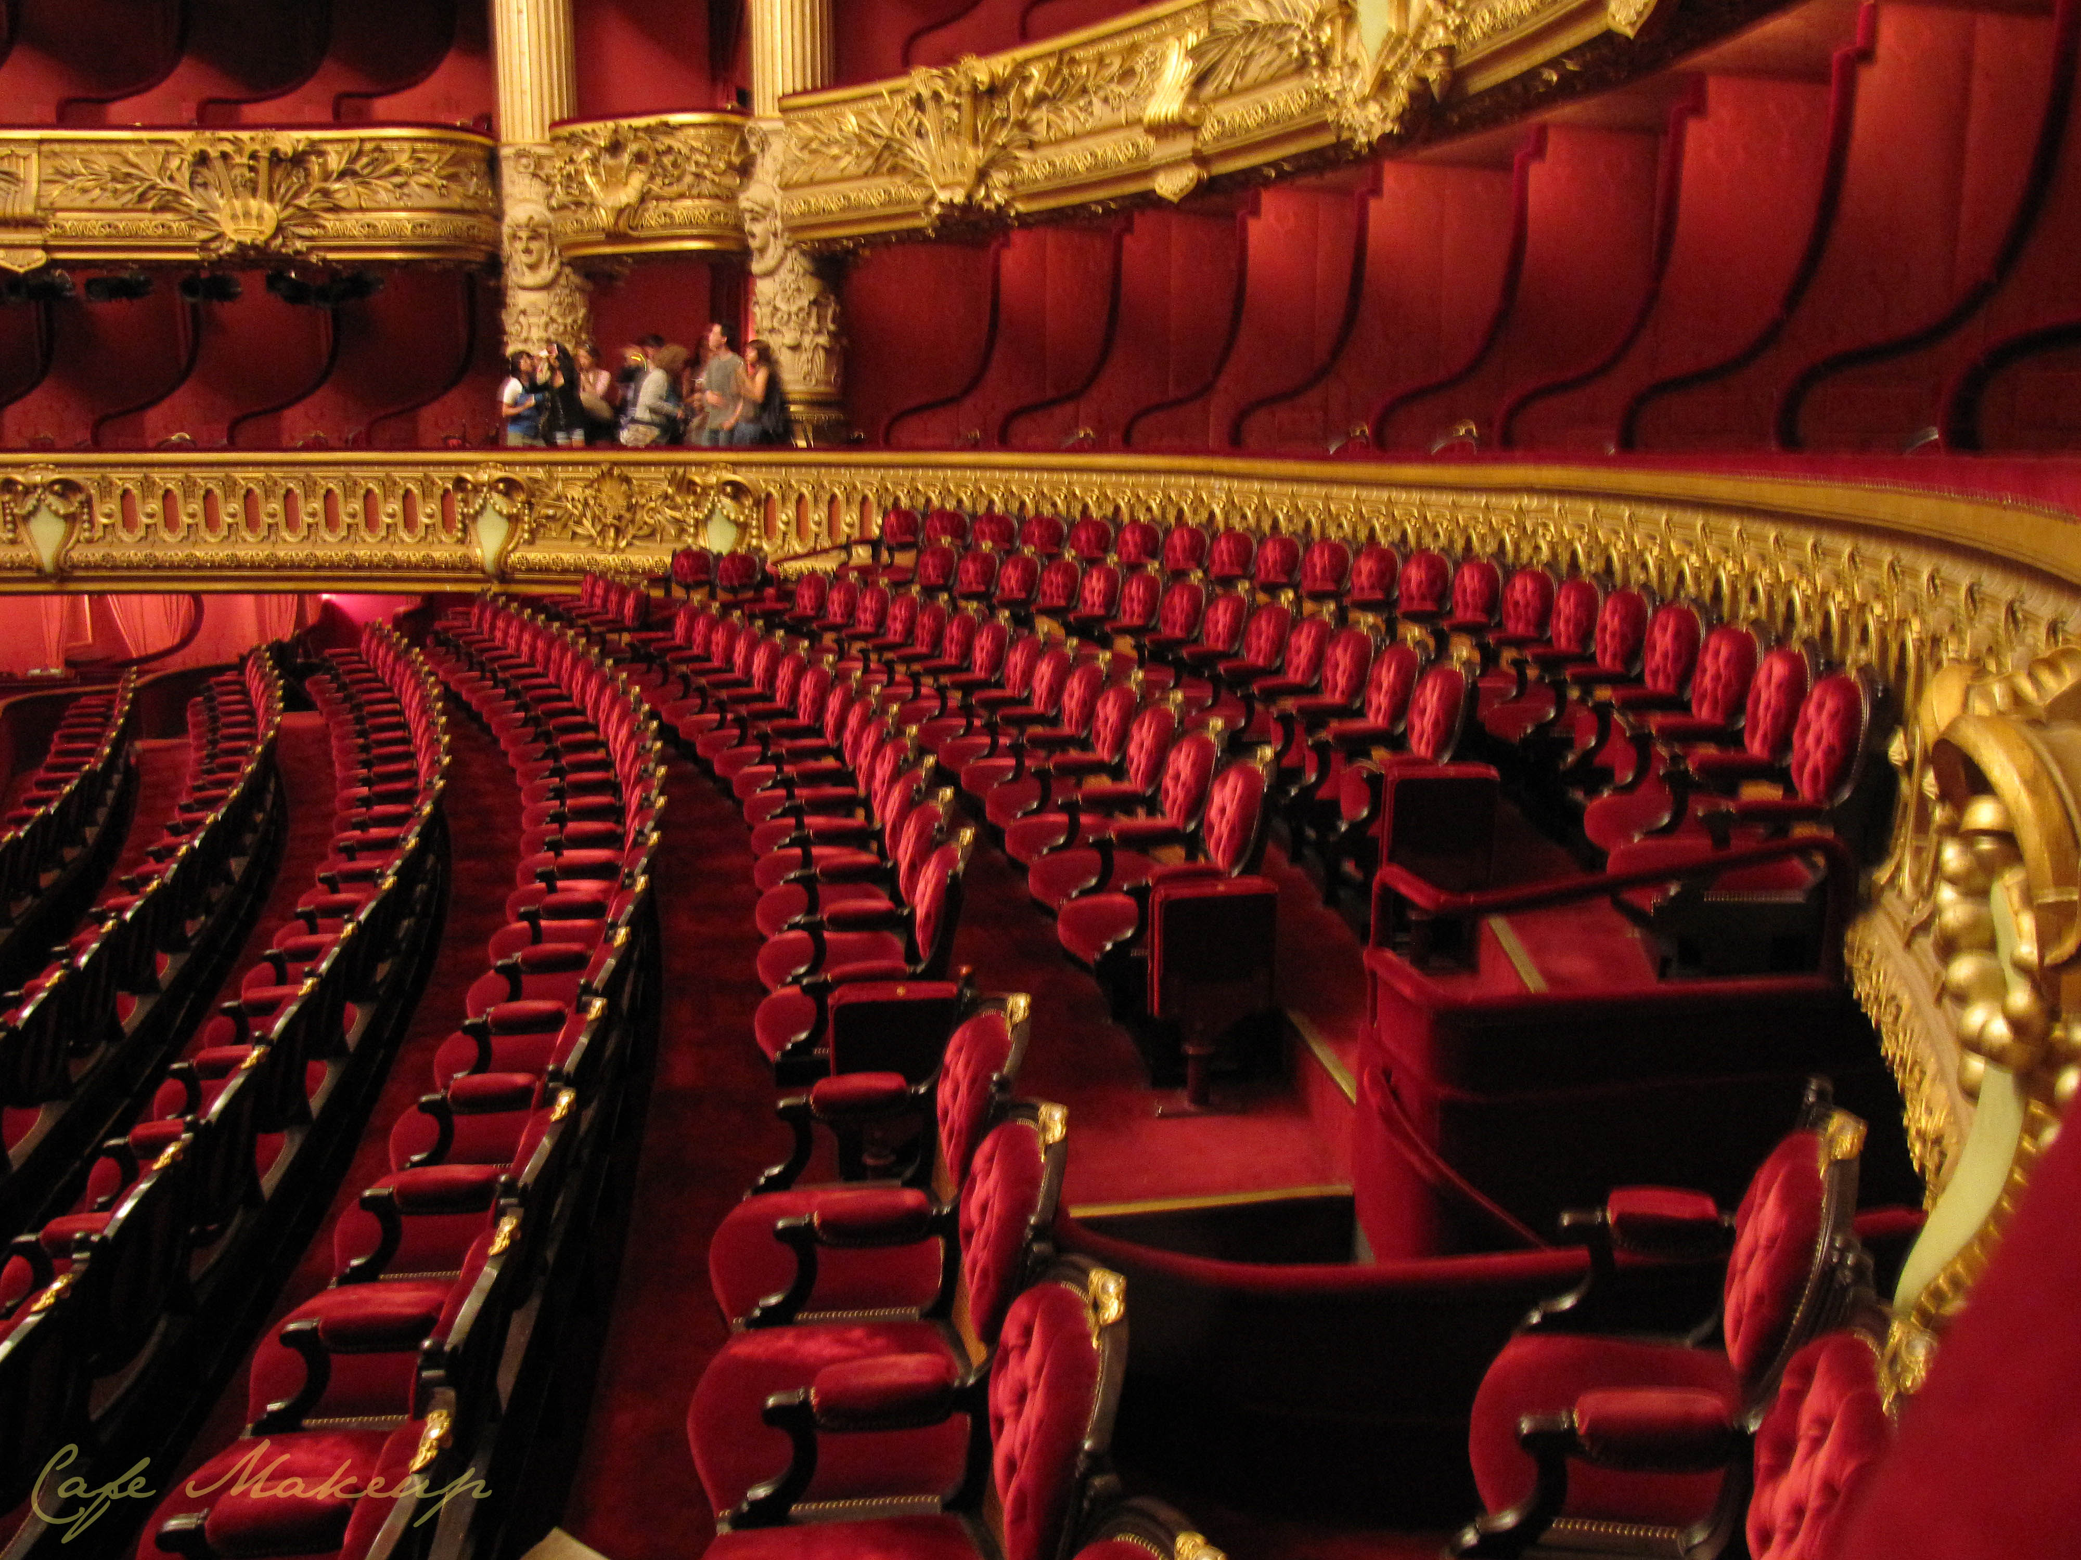
Theatre
Curved rows so everyone can see everyone
Red upholstery is to reflect pink light to make ladies look their best

Slide 14
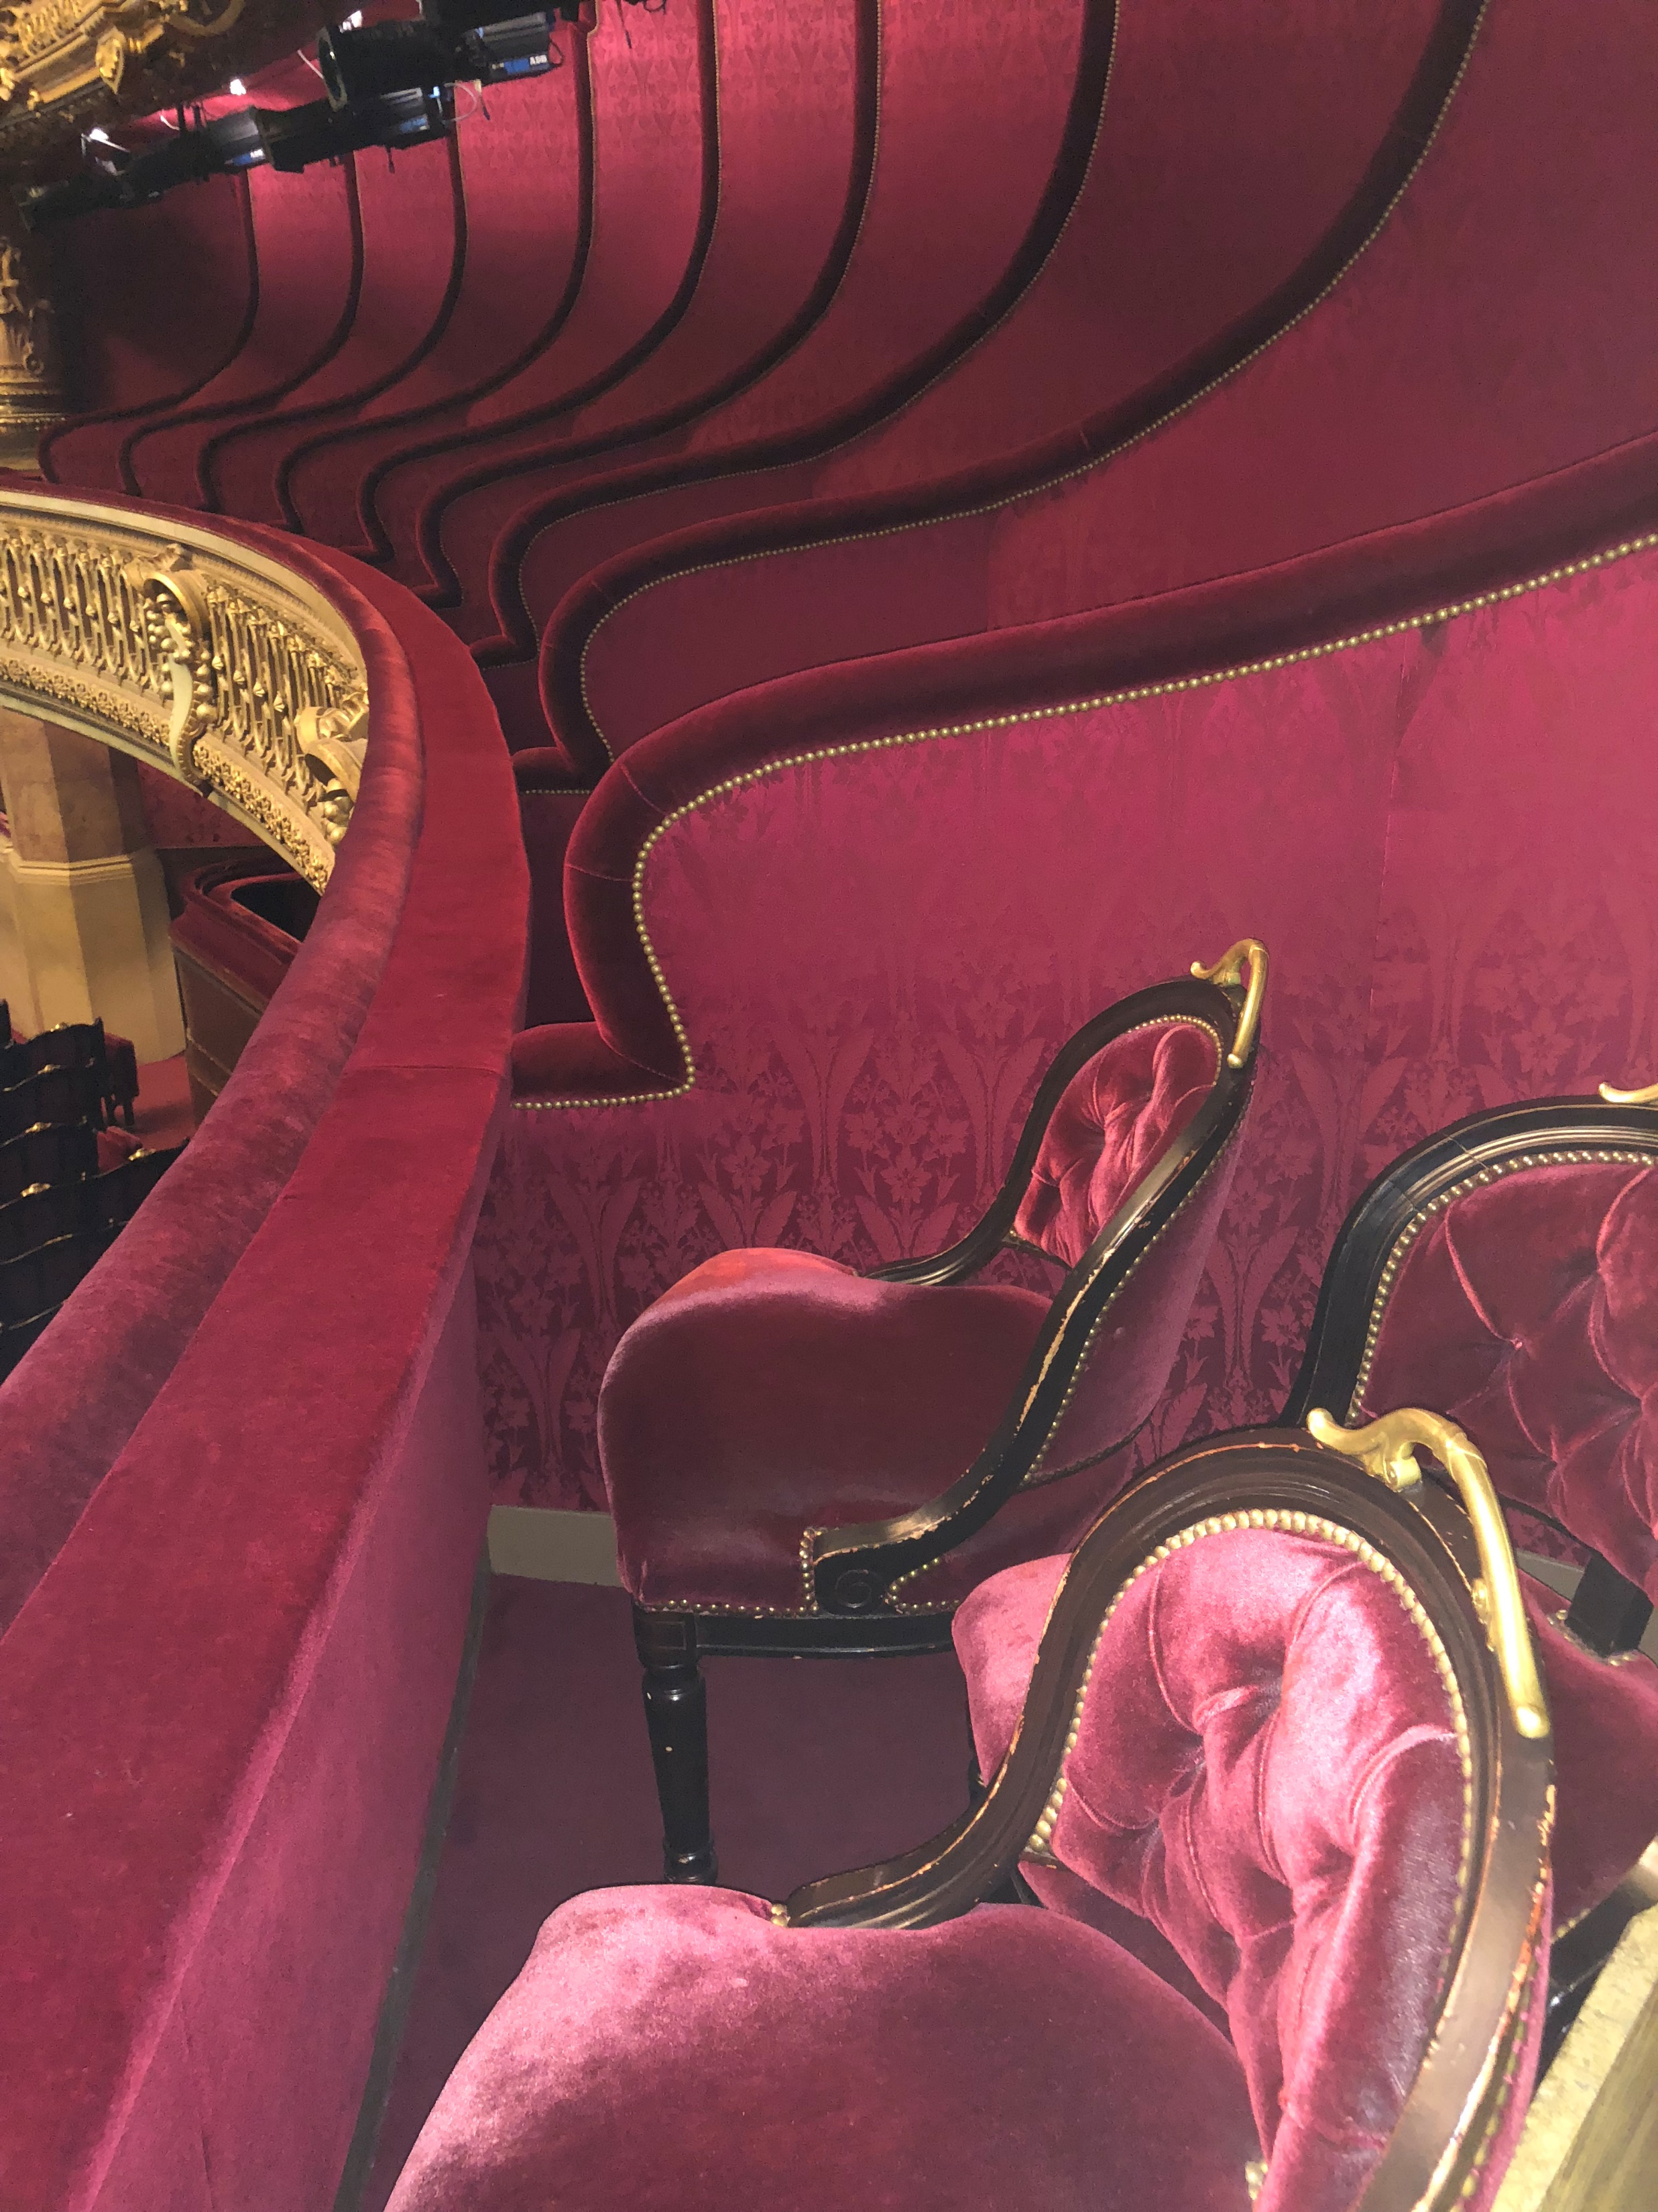
Theatre
Boxes arranged so everyone can see everyone

Slide 15
See and be seen
By designing first for the real job to be done, Garnier
delighted patrons
created the model for most concert halls to come
set a good precedent for designing anything

