Slide 1
Needlessly wide tables
A combover
for data
View in slideshow mode
John Boykin
info@ApplegateLLC.com

Slide 2
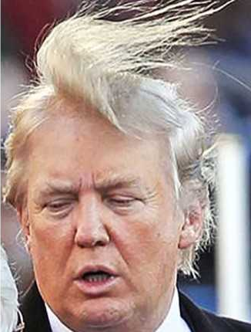
We wouldn’t think of larding up a screen with superfluous words just to fill up space
The Ming Dynasty ruled China from 1368 to 1644, and it was under its aegis, during the first half of the 15th century, that technological and design advances brought milky white and cobalt-blue porcelain to perfection.
The most internationally sought-after of all ceramics, Ming products became synonymous with the country that produced them, referred to in India and the Middle East as “chini” and in English as “china.”
But this artistic high point was just one of the many achievements of the Ming Dynasty between 1400 and 1450, as shown by “Ming: 50 years that changed China,” in the recently opened Sainsbury Exhibitions Gallery at the British Museum. The show runs from Sept. 18 until Jan. 5, 2015.
Five years in the planning, this dazzling show is curated by Professor Craig Clunas of Oxford University and Jessica Harrison-Hall of the British Museum.
With its population of around 85 million, 15th-century Ming China was by far the largest state on the globe. As Professor Clunas points out in the exhibition’s exemplary catalog, everything about it was on a grand scale: “It had a greater land area, bigger cities (and more big cities), bigger armies, bigger ships, bigger palaces, bigger bells, more literate people, more religious professionals.”

Slide 3
We wouldn’t think of stretching text to distortion to fill up space.
The Ming Dynasty ruled China from 1368 to 1644, and it was under its aegis, during the first half of the 15th century, that technological and design advances brought milky white and cobalt-blue porcelain to perfection.
The most internationally sought-after of all ceramics, Ming products became synonymous with the country that produced them, referred to in India and the Middle East as “chini” and in English as “china.”
But this artistic high point was just one of the many achievements of the Ming Dynasty between 1400 and 1450, as shown by “Ming: 50 years that changed China,” in the recently opened Sainsbury Exhibitions Gallery at the British Museum. The show runs from Sept. 18 until Jan. 5, 2015.

Slide 4
We wouldn’t think of stretching a photo to distortion to fill up space.

Slide 5
So why do we routinely fill up space with needlessly wide tables?

Slide 6
So why do we routinely fill up space with needlessly wide tables?

Slide 7
So why do we routinely fill up space with needlessly wide tables?

Slide 8
Needlessly wide tables
&
combovers
are both ill-advised ways of filling up space

Slide 9
Gestalt principle of proximity
We perceive things close together
as more related than things far apart
In other words…
Distance weakens relation & requires effort to associate

Slide 10
Tables are odd beasts
In tables, no item means anything except in relation to some other item
Date + amount + label
Label + value

Slide 11
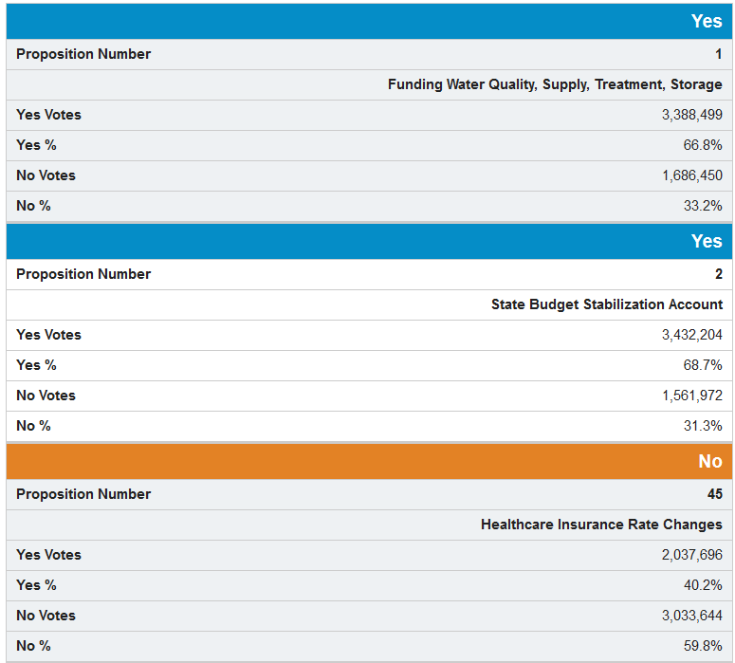
Needlessly wide tables disrupt relations: Bad for accessibility

Slide 12
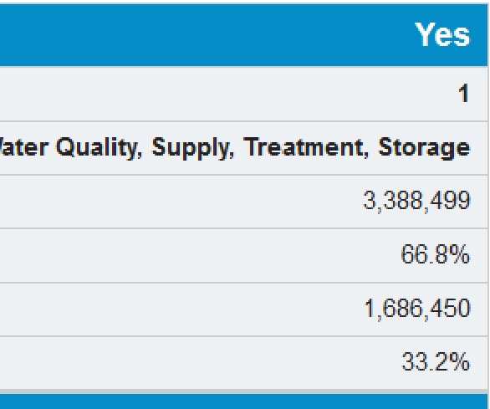
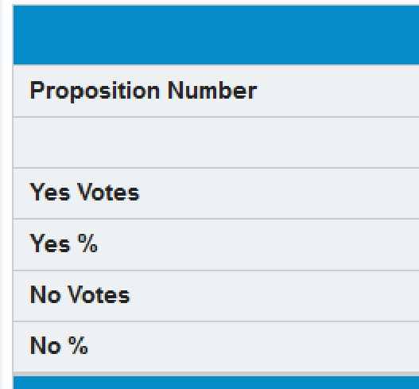
Needlessly wide tables disrupt relations: Bad for accessibility

Slide 13
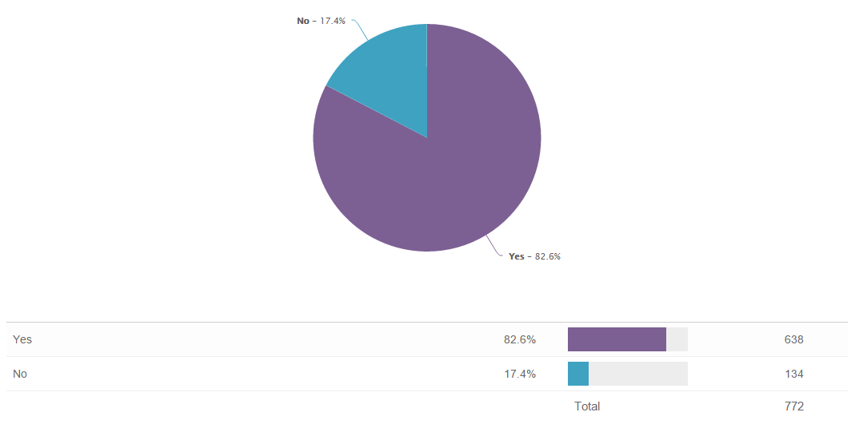
Needlessly wide tables are everywhere

Slide 14
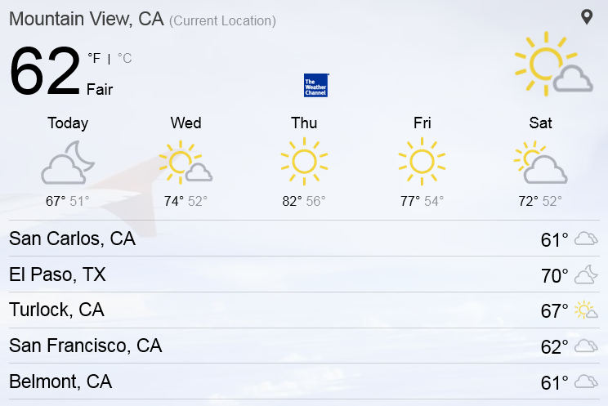
Needlessly wide tables are everywhere

Slide 15
Needlessly wide tables are everywhere

Slide 16
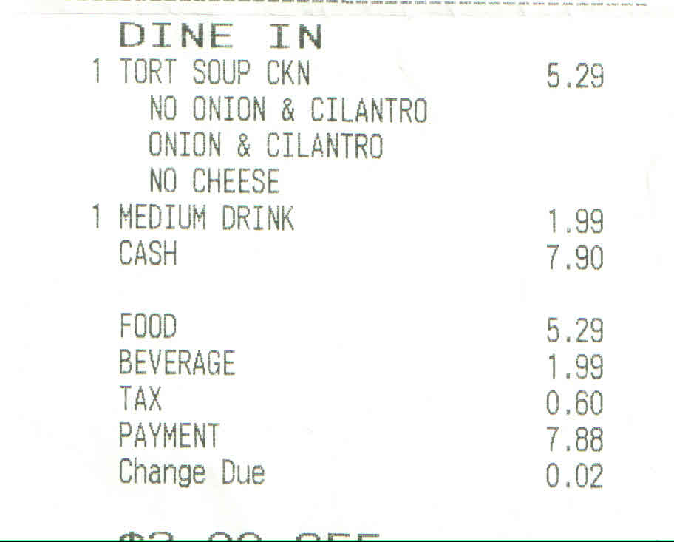
Needlessly wide tables are everywhere

Slide 17
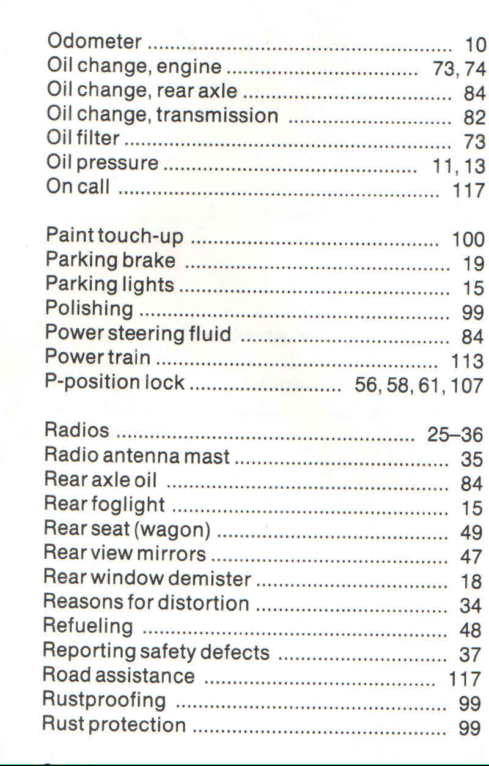
Needlessly wide tables are everywhere

Slide 18
Reconsidering needlessly
wide
tables

Slide 19
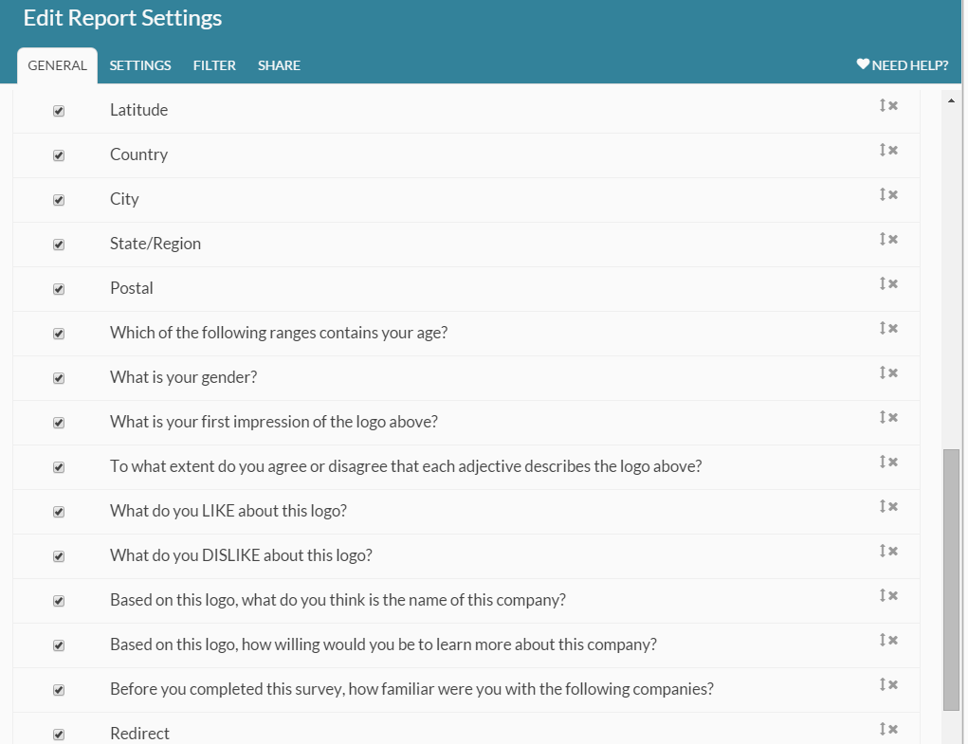
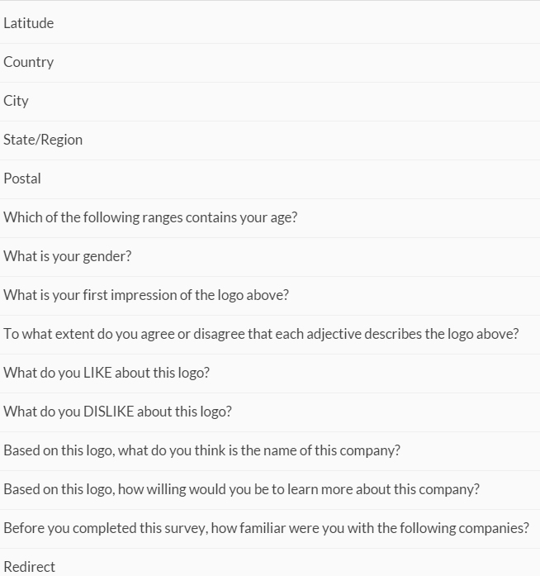
Typical pattern:
Left elements same width
Right elements same width
Middle elements varied widths

Slide 20
Reconsidering needlessly wide tables

Slide 21
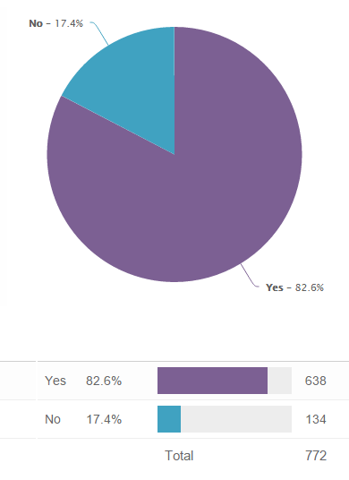
Reconsidering needlessly wide tables

Slide 22
Reconsidering needlessly wide tables

Slide 23
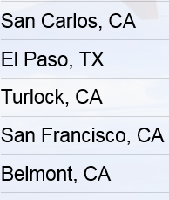
Reconsidering needlessly wide tables
Entire width is still tappable for mobile

Slide 24
A few guidelines for tables
Each column should be just wide enough to comfortably accommodate its actual contents + appropriate padding – even (especially) in responsive design
Columns should be no further apart than necessary to tell them apart
Columns whose contents vary the most in width should generally go in the rightmost position
Outlier-length content should wrap or be truncated

Slide 25
It is what it is. Let it be.

Slide 26
It is what it is. Let it be.

